Slide 1
Linear Transmit Processing in MIMO Communications Systems
Michael Joham, Member, IEEE, Wolfgang Utschick, Member IEEE, and Josef A.Nossek, Fellow, IEEE

Slide 2
Table of Contents
Abstract
Introduction
System Model
Receive Filters
Transmit Matched Filter (TxMF)
Transmit Zero-Forcing Filter (TxZF)
Transmit Wiener Filter (TxWF)

Slide 3
Abstract
Examine and compare to the different types of linear transmit processing for MIMO.
Receive filter is independent of the transmit filter contrary to the joint optimization.
Identifying three filter types which is similar to the receive processing.
The transmit matched filter, The transmit zero-forcing filter, the transmit wiener filter.
With an additional constraint for the transmit power, they are based on similar optimizations as the respective receive filters.
Transmit Wiener filter and Receive Wiener filter has similar convergence properties.
Transmit Wiener filter converges to the matched filter and zero forcing filter for low and high SNR .
Simulations reveal that the bit-error ratio results are different for both receive and transmit filters.

Slide 4
Introduction
The three fundamental types of receive filter are the match filter (RxMF), the zero forcing filter (RxZF), the wiener filter (TxWF).
The major drawback of the receive filters.
Channel estimation and adaptation of receiver can increase the complexity of the receiver
The downlink channel impulse response need to be available at base station (BS) for the transmit processing.
The main advantage of transmit processing is simplifying the receivers i.e., the MSs.
Paper contribution:
Transmit and receive filters follow similar optimization process.
After deriving TxWF, we show that it is convergence to the other transmit filters for low and high SNR
Comparing transmit filters and analytically proving that TxZF’s MSE is lower bounded by the TxMF at low SNR
And upper bounded by the MSE of TxMF for high SNR.
The MSEs of transmit filters are identical for uncorrelated symbols and noise.

Slide 5
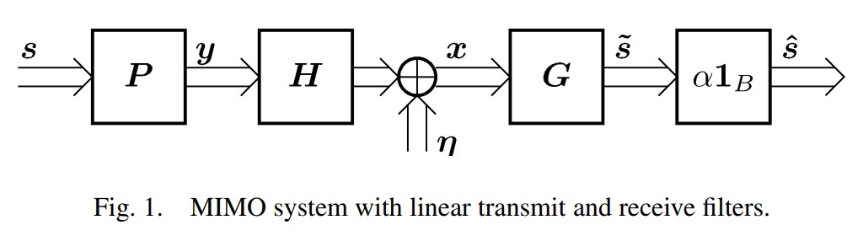
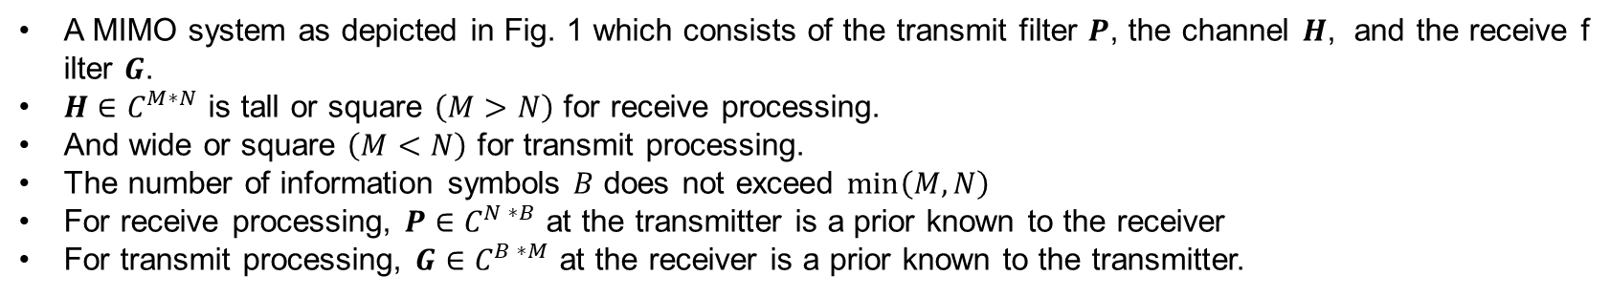
System Model
A MIMO system as depicted in Fig. 1 which consists of the transmit filter $P$, the channel $H$, and the receive filter $G$.
$H∈C^{M∗N}$ is tall or square $\left(M>N\right)$ for receive processing.
And wide or square $\left(M<N\right)$ for transmit processing.
The number of information symbols $B$ does not exceed $\min\left(M,N\right)$
For receive processing, $P∈C^{N ∗B}$ at the transmitter is a prior known to the receiver
For transmit processing, $G∈C^{B ∗M}$ at the receiver is a prior known to the transmitter.

Slide 6
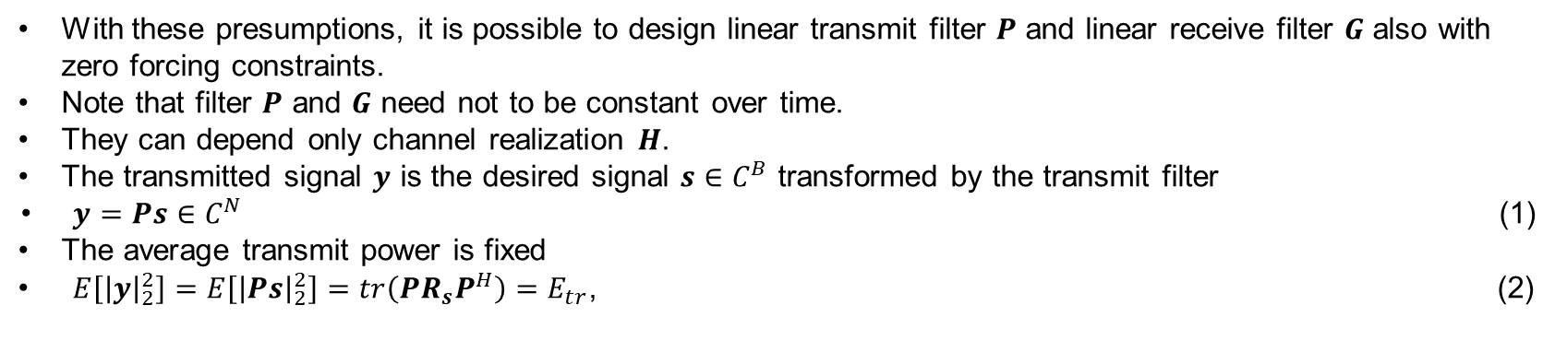
System Model
With these presumptions, it is possible to design linear transmit filter $P$ and linear receive filter $G$ also with zero forcing constraints.
Note that filter $P$ and $G$ need not to be constant over time.
They can depend only channel realization $H$.
The transmitted signal $y$ is the desired signal $s∈C^{B}$ transformed by the transmit filter
$y=Ps∈C^{N}$ (1)
The average transmit power is fixed
$E\left[{\left|y\right|}_{2}^{2}\right]=E\left[{\left|Ps\right|}_{2}^{2}\right]=tr\left(PR_{s}P^{H}\right)=E_{tr}$, (2)

Slide 7
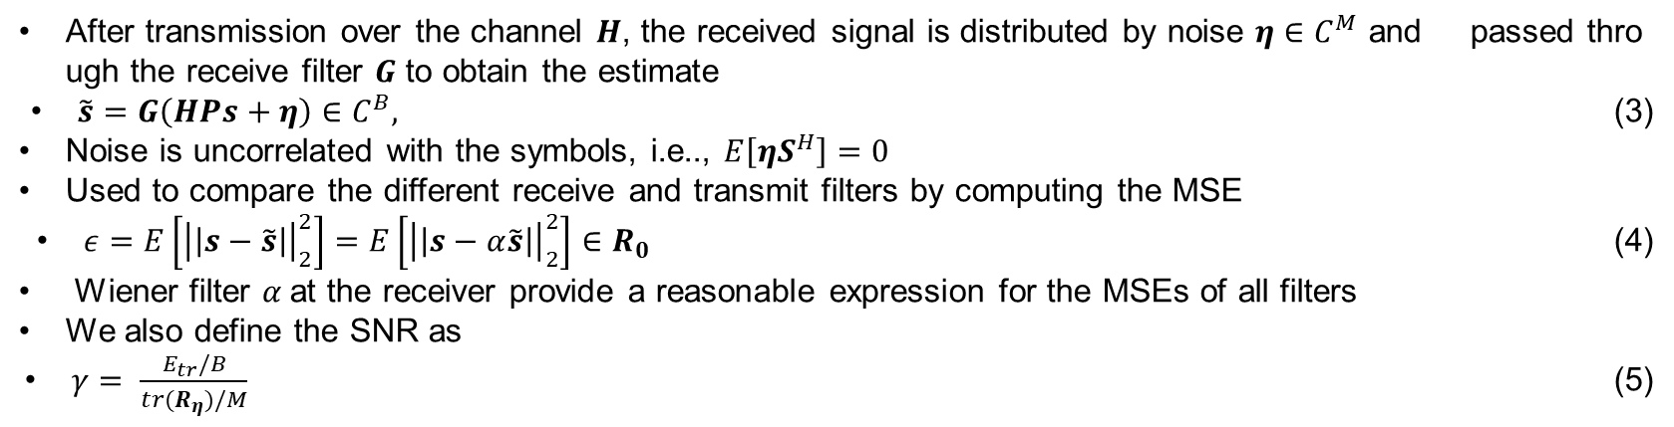
System Model
After transmission over the channel $H$, the received signal is distributed by noise $η∈C^{M}$ and passed through the receive filter $G$ to obtain the estimate
$\tilde{s}=G\left(HPs+η\right)∈C^{B},$ (3)
Noise is uncorrelated with the symbols, i.e.., $E\left[ηS^{H}\right]=0$
Used to compare the different receive and transmit filters by computing the MSE
$ε=E\left[{\left|\left|s−\tilde{s}\right|\right|}_{2}^{2}\right]=E\left[{\left|\left|s−α\tilde{s}\right|\right|}_{2}^{2}\right]∈R_{0}$ (4)
Wiener filter $α$at the receiver provide a reasonable expression for the MSEs of all filters
We also define the SNR as
$γ= \frac{E_{tr}/B}{tr(R_{η})/M}$ (5)

Slide 8
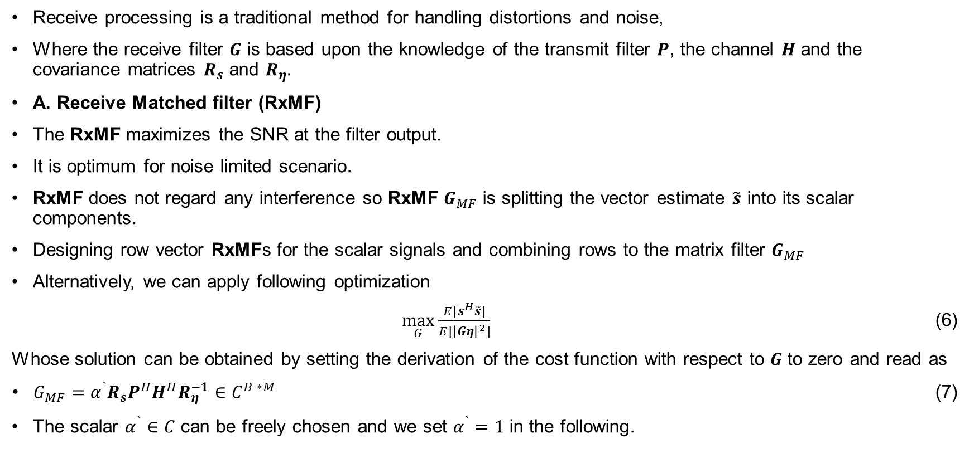
Receive Filters
Receive processing is a traditional method for handling distortions and noise,
Where the receive filter $G$ is based upon the knowledge of the transmit filter $P$, the channel $H$ and the covariance matrices $R_{s}$ and $R_{η}.$
A. Receive Matched filter (RxMF)
The RxMF maximizes the SNR at the filter output.
It is optimum for noise limited scenario.
RxMF does not regard any interference so RxMF $G_{MF}$ is splitting the vector estimate $\tilde{s}$ into its scalar components.
Designing row vector RxMFs for the scalar signals and combining rows to the matrix filter $G_{MF}$
Alternatively, we can apply following optimization
$\max_{G}{\frac{E[s^{H}\tilde{s}]}{E[{\left|Gη\right|}^{2}]}}$ (6)
Whose solution can be obtained by setting the derivation of the cost function with respect to $G$ to zero and read as
$G_{MF}=α^{`}{R_{s}P}^{H}H^{H}R_{η}^{−1}∈C^{B ∗M}$ (7)
The scalar $α^{`}∈C$ can be freely chosen and we set $α^{`}=1$ in the following.

Slide 9
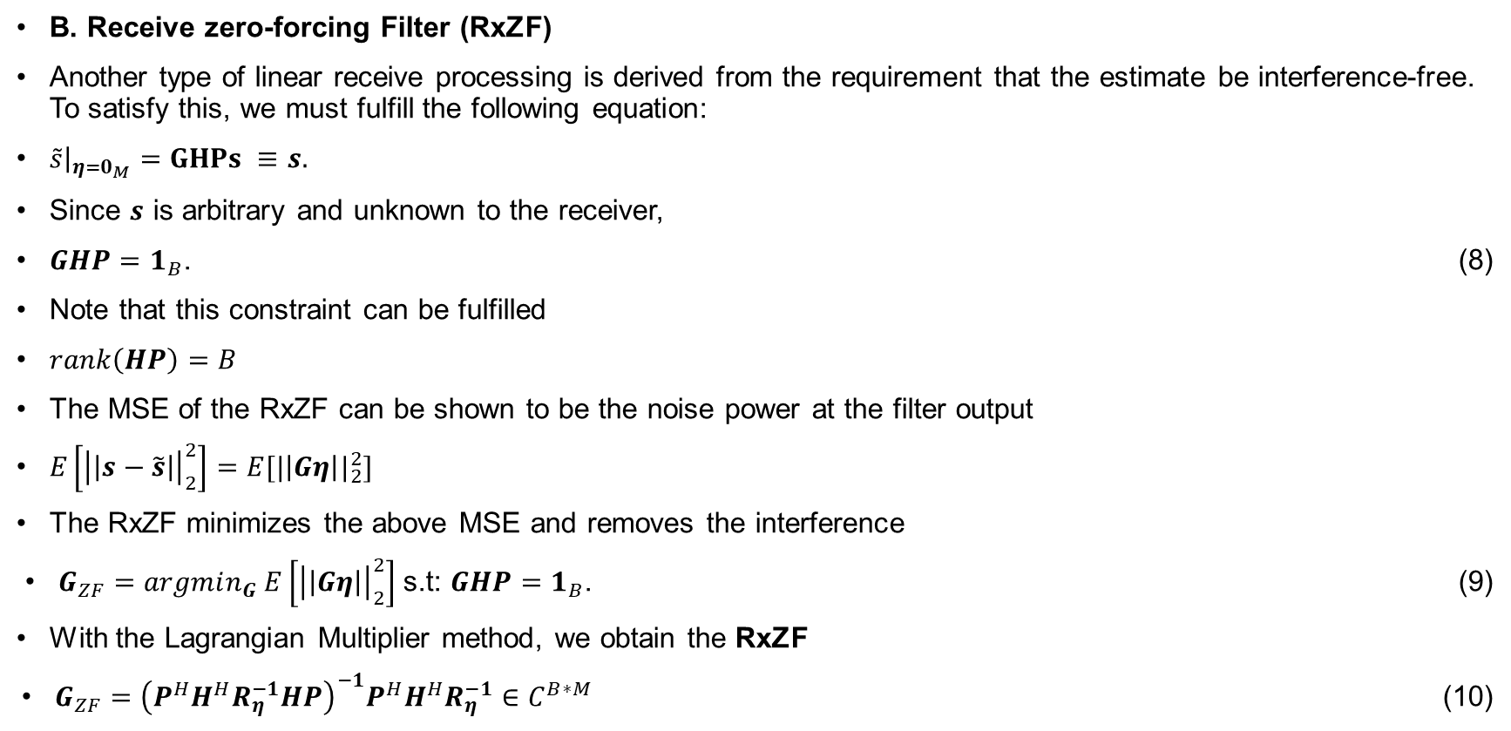
Receive Filters
B. Receive zero-forcing Filter (RxZF)
Another type of linear receive processing is derived from the requirement that the estimate be interference-free. To satisfy this, we must fulfill the following equation:
$\tilde{s}{\left.​\right|}_{η=0_{M}}=GHPs ≡s.$
Since $s$ is arbitrary and unknown to the receiver,
$GHP=1_{B}$. (8)
Note that this constraint can be fulfilled
$rank\left(HP\right)=B$
The MSE of the RxZF can be shown to be the noise power at the filter output
$E\left[{\left|\left|s−\tilde{s}\right|\right|}_{2}^{2}\right]=E[{|\left|Gη\right||}_{2}^{2}]$
The RxZF minimizes the above MSE and removes the interference
$G_{ZF}=argmin_{G} E\left[{\left|\left|Gη\right|\right|}_{2}^{2}\right]$s.t: $GHP=1_{B}$. (9)
With the Lagrangian Multiplier method, we obtain the RxZF
$G_{ZF}={\left(P^{H}H^{H}R_{η}^{−1}HP\right)}^{−1}P^{H}H^{H}R_{η}^{−1}∈C^{B∗M}$ (10)

Slide 10
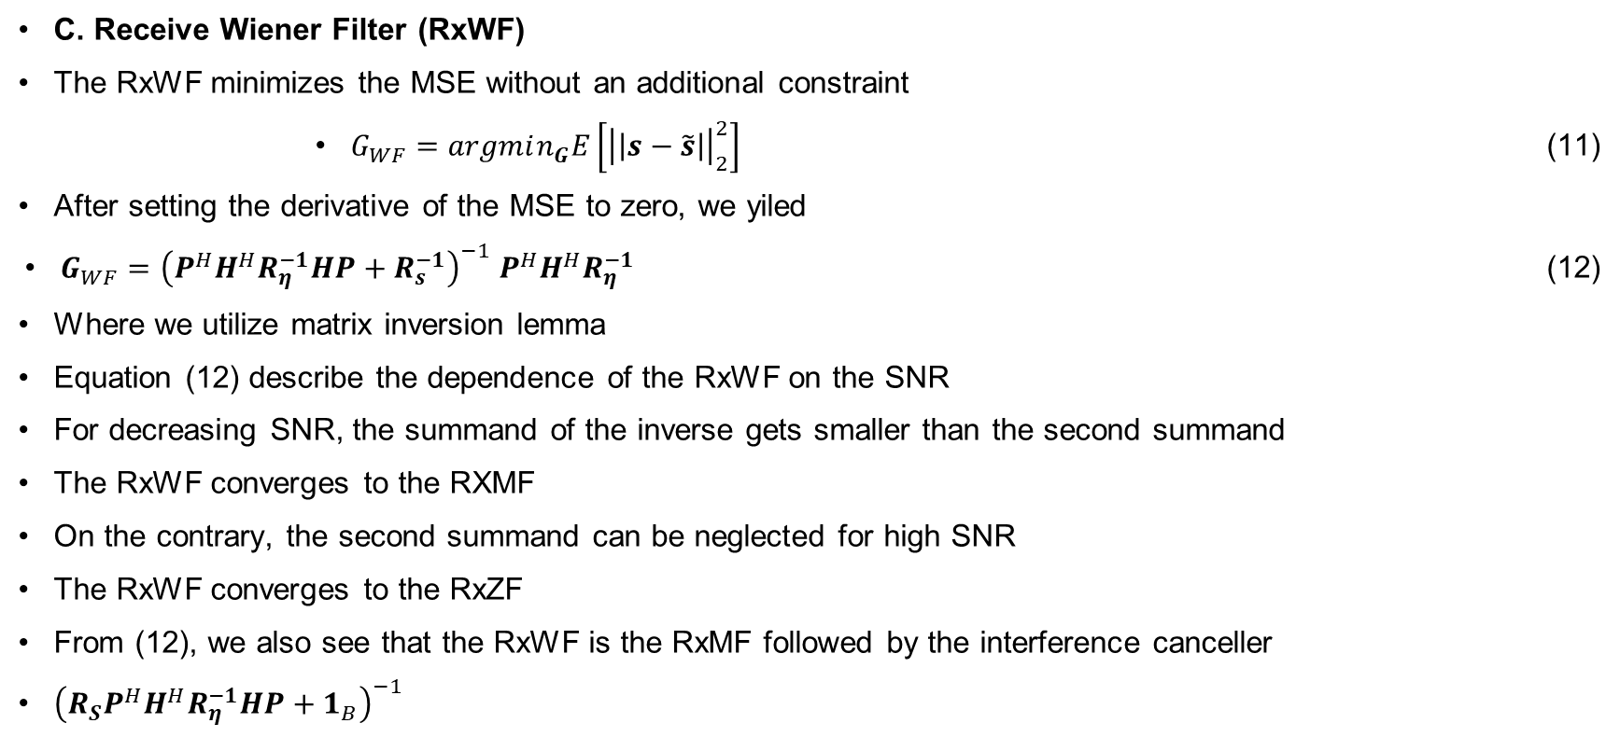
Receive Filters
C. Receive Wiener Filter (RxWF)
The RxWF minimizes the MSE without an additional constraint
$G_{WF}=argmin_{G}E\left[{\left|\left|s−\tilde{s}\right|\right|}_{2}^{2}\right]$ (11)
After setting the derivative of the MSE to zero, we yiled
$G_{WF}={\left(P^{H}H^{H}R_{η}^{−1}HP+R_{s}^{−1}\right)}^{−1} P^{H}H^{H}R_{η}^{−1}$ (12)
Where we utilize matrix inversion lemma
Equation (12) describe the dependence of the RxWF on the SNR
For decreasing SNR, the summand of the inverse gets smaller than the second summand
The RxWF converges to the RXMF
On the contrary, the second summand can be neglected for high SNR
The RxWF converges to the RxZF
From (12), we also see that the RxWF is the RxMF followed by the interference canceller
${\left(R_{S}P^{H}H^{H}R_{η}^{−1}HP+1_{B}\right)}^{−1}$

Slide 11
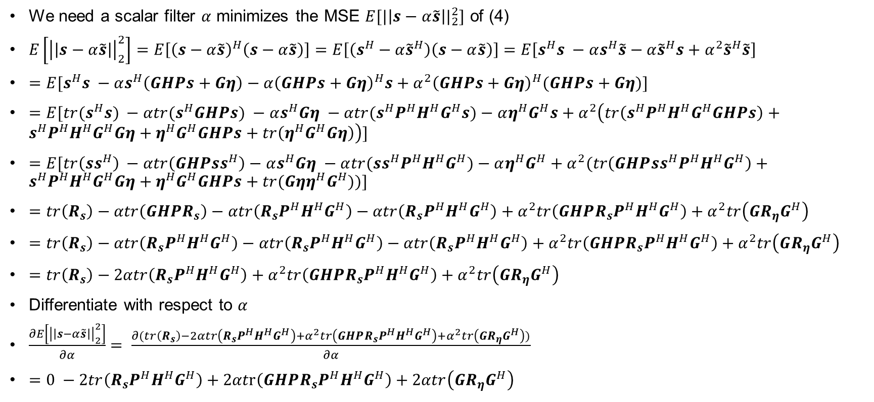
Receive Filters
We need a scalar filter $α$ minimizes the MSE $E[{|\left|s−α\tilde{s}\right||}_{2}^{2}]$ of (4)
$E\left[{\left|\left|s−α\tilde{s}\right|\right|}_{2}^{2}\right]=E\left[{\left(s−α\tilde{s}\right)}^{H}\left(s−α\tilde{s}\right)\right]=E\left[\left(s^{H}−α{\tilde{s}}^{H}\right)\left(s−α\tilde{s}\right)\right]=E\left[s^{H}s −αs^{H}\tilde{s}−α{\tilde{s}}^{H}s+α^{2}{\tilde{s}}^{H}\tilde{s}\right]$
$=E[s^{H}s −αs^{H}\left(GHPs+Gη\right)−α{\left(GHPs+Gη\right)}^{H}s+α^{2}{\left(GHPs+Gη\right)}^{H}(GHPs+Gη)]$
$=E[{tr(s}^{H}s) −αtr(s^{H}GHPs) −αs^{H}Gη −αtr(s^{H}P^{H}H^{H}G^{H}s)−αη^{H}G^{H}s+α^{2}\left(tr\left(s^{H}P^{H}H^{H}G^{H}GHPs\right)+s^{H}P^{H}H^{H}G^{H}Gη+η^{H}G^{H}GHPs+tr\left(η^{H}G^{H}Gη\right)\right)]$
$=E[tr\left(ss^{H}\right) −αtr\left(GHPss^{H}\right)−αs^{H}Gη −α{tr(ss}^{H}P^{H}H^{H}G^{H})−αη^{H}G^{H}+α^{2}(tr\left(GHP{ss}^{H}P^{H}H^{H}G^{H}\right)+s^{H}P^{H}H^{H}G^{H}Gη+η^{H}G^{H}GHPs+tr({Gηη}^{H}G^{H}))]$
$=tr\left(R_{s}\right)−αtr\left(GHPR_{s}\right)−αtr\left(R_{s}P^{H}H^{H}G^{H}\right)−αtr\left(R_{s}P^{H}H^{H}G^{H}\right)+α^{2}tr\left(GHPR_{s}P^{H}H^{H}G^{H}\right)+α^{2}tr\left(GR_{η}G^{H}\right)$
$=tr\left(R_{s}\right)−αtr\left(R_{s}P^{H}H^{H}G^{H}\right)−αtr\left(R_{s}P^{H}H^{H}G^{H}\right)−αtr\left(R_{s}P^{H}H^{H}G^{H}\right)+α^{2}tr\left(GHPR_{s}P^{H}H^{H}G^{H}\right)+α^{2}tr\left(GR_{η}G^{H}\right)$
$=tr\left(R_{s}\right)−2αtr\left(R_{s}P^{H}H^{H}G^{H}\right)+α^{2}tr\left(GHPR_{s}P^{H}H^{H}G^{H}\right)+α^{2}tr\left(GR_{η}G^{H}\right)$
Differentiate with respect to $α$
$\frac{∂E\left[{\left|\left|s−α\tilde{s}\right|\right|}_{2}^{2}\right]}{∂α}= \frac{∂(tr\left(R_{s}\right)−2αtr\left(R_{s}P^{H}H^{H}G^{H}\right)+α^{2}tr\left(GHPR_{s}P^{H}H^{H}G^{H}\right)+α^{2}tr\left(GR_{η}G^{H}\right))}{∂α}$
$=0 −2tr\left(R_{s}P^{H}H^{H}G^{H}\right)+2αtr\left(GHPR_{s}P^{H}H^{H}G^{H}\right)+2αtr\left(GR_{η}G^{H}\right)$

Slide 12
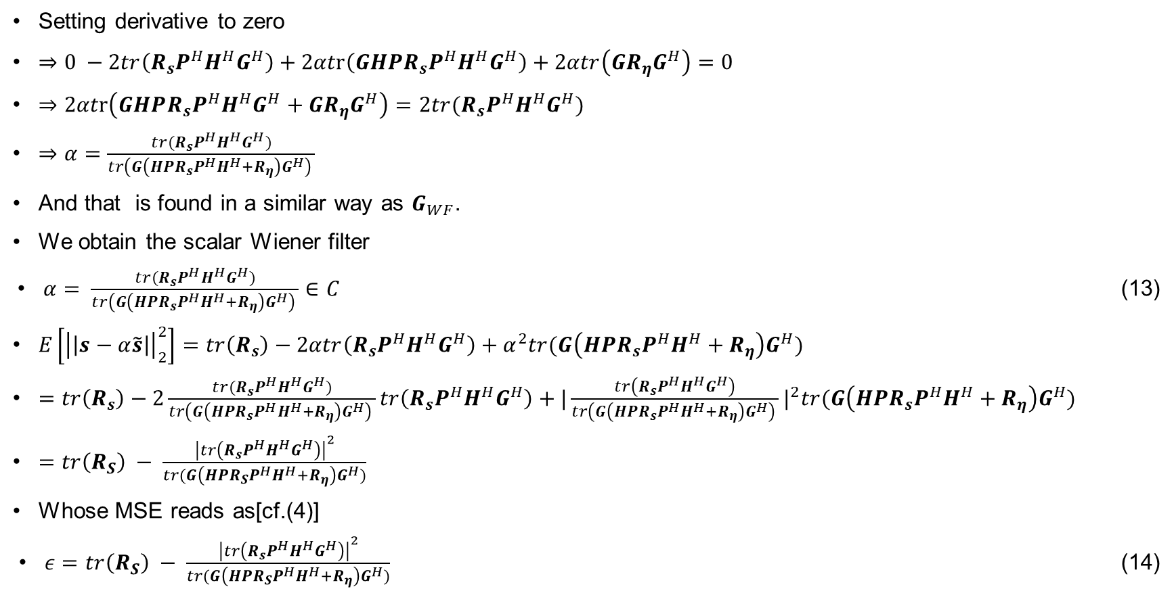
Receive Filters
Setting derivative to zero
$⇒0 −2tr\left(R_{s}P^{H}H^{H}G^{H}\right)+2αtr\left(GHPR_{s}P^{H}H^{H}G^{H}\right)+2αtr\left(GR_{η}G^{H}\right)=0$
$⇒2αtr\left(GHPR_{s}P^{H}H^{H}G^{H}+GR_{η}G^{H}\right)=2tr(R_{s}P^{H}H^{H}G^{H})$
$⇒α=\frac{tr(R_{s}P^{H}H^{H}G^{H})}{tr\left(G\left(HPR_{s}P^{H}H^{H}+R_{η}\right)G^{H}\right) }$
And that is found in a similar way as $G_{WF}$.
We obtain the scalar Wiener filter
$α= \frac{tr(R_{s}P^{H}H^{H}G^{H})}{tr\left(G\left(HPR_{s}P^{H}H^{H}+R_{η}\right)G^{H}\right) }∈C$ (13)
$E\left[{\left|\left|s−α\tilde{s}\right|\right|}_{2}^{2}\right]=tr\left(R_{s}\right)−2αtr\left(R_{s}P^{H}H^{H}G^{H}\right)+α^{2}tr(G\left(HPR_{s}P^{H}H^{H}+R_{η}\right)G^{H})$
$=tr\left(R_{s}\right)−2\frac{tr(R_{s}P^{H}H^{H}G^{H})}{tr\left(G\left(HPR_{s}P^{H}H^{H}+R_{η}\right)G^{H}\right) }tr\left(R_{s}P^{H}H^{H}G^{H}\right)+{|\frac{tr\left(R_{s}P^{H}H^{H}G^{H}\right)}{tr\left(G\left(HPR_{s}P^{H}H^{H}+R_{η}\right)G^{H}\right) }|}^{2}tr(G\left(HPR_{s}P^{H}H^{H}+R_{η}\right)G^{H})$
$=tr\left(R_{S}\right) − \frac{{\left|tr\left(R_{s}P^{H}H^{H}G^{H}\right)\right|}^{2}}{tr(G\left(HPR_{S}P^{H}H^{H}+R_{η}\right)G^{H})}$
Whose MSE reads as[cf.(4)]
$ε=tr\left(R_{S}\right) − \frac{{\left|tr\left(R_{s}P^{H}H^{H}G^{H}\right)\right|}^{2}}{tr(G\left(HPR_{S}P^{H}H^{H}+R_{η}\right)G^{H})}$ (14)

Slide 13
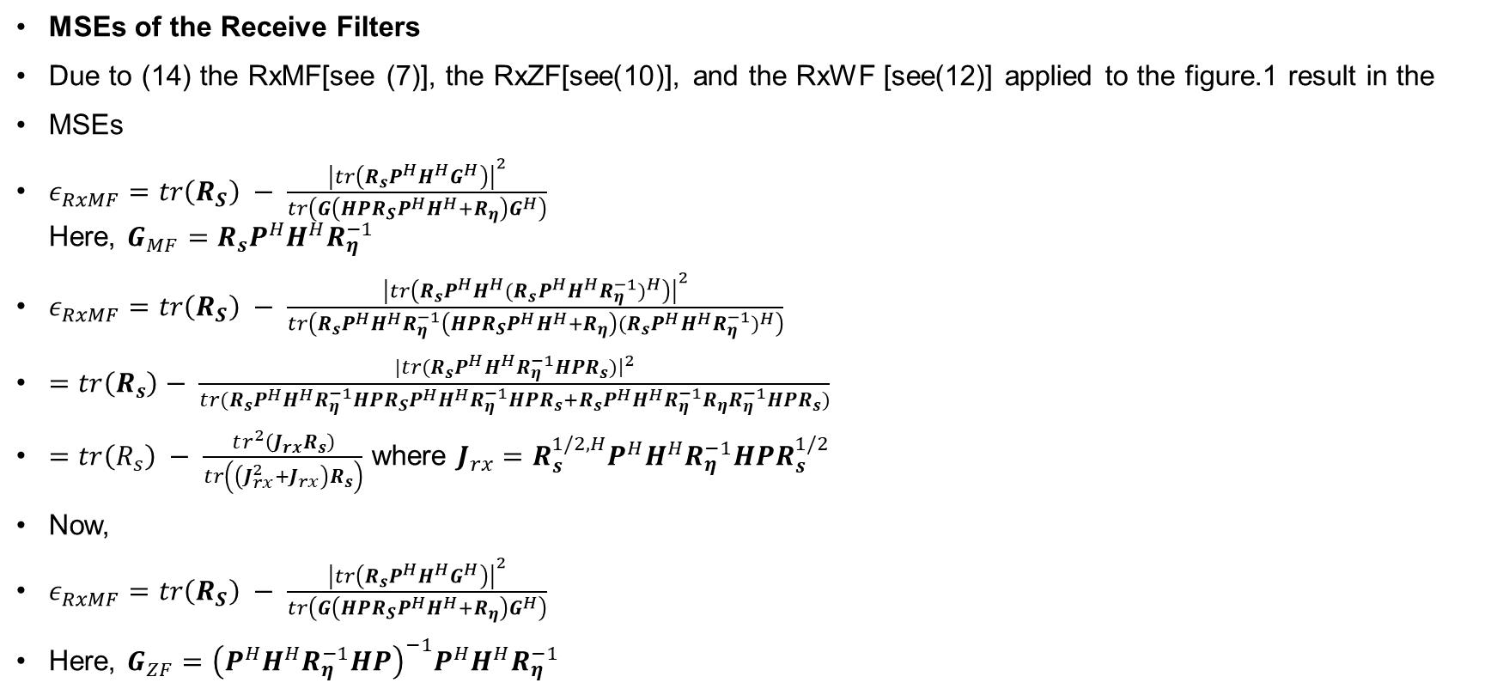
Receive Filters
MSEs of the Receive Filters
Due to (14) the RxMF[see (7)], the RxZF[see(10)], and the RxWF [see(12)] applied to the figure.1 result in the
MSEs
$ε_{RxMF}=tr\left(R_{S}\right) − \frac{{\left|tr\left(R_{s}P^{H}H^{H}G^{H}\right)\right|}^{2}}{tr\left(G\left(HPR_{S}P^{H}H^{H}+R_{η}\right)G^{H}\right)}$ Here, $G_{MF}=R_{s}P^{H}H^{H}R_{η}^{−1}$
$ε_{RxMF}=tr\left(R_{S}\right) − \frac{{\left|tr\left(R_{s}P^{H}H^{H}{{(R}_{s}P^{H}H^{H}R_{η}^{−1})}^{H}\right)\right|}^{2}}{tr\left(R_{s}P^{H}H^{H}R_{η}^{−1}\left(HPR_{S}P^{H}H^{H}+R_{η}\right){(R_{s}P^{H}H^{H}R_{η}^{−1})}^{H}\right)}$
$=tr\left(R_{s}\right)− \frac{|tr(R_{s}P^{H}H^{H}R_{η}^{−1}HPR_{s}){\left.​\right|}^{2}}{tr(R_{s}P^{H}H^{H}R_{η}^{−1}HPR_{S}P^{H}H^{H}R_{η}^{−1}HPR_{s}+R_{s}P^{H}H^{H}R_{η}^{−1}R_{η}R_{η}^{−1}HPR_{s})}$
$=tr\left(R_{s}\right) − \frac{tr^{2}\left(J_{rx}R_{s}\right)}{tr\left(\left(J_{rx}^{2}+J_{rx}\right)R_{s}\right)}$ where $J_{rx}=R_{s}^{1/2,H}P^{H}H^{H}R_{η}^{−1}HPR_{s}^{1/2}$
Now,
$ε_{RxMF}=tr\left(R_{S}\right) − \frac{{\left|tr\left(R_{s}P^{H}H^{H}G^{H}\right)\right|}^{2}}{tr\left(G\left(HPR_{S}P^{H}H^{H}+R_{η}\right)G^{H}\right)}$
Here, $G_{ZF}={\left(P^{H}H^{H}R_{η}^{−1}HP\right)}^{−1}P^{H}H^{H}R_{η}^{−1}$

Slide 14
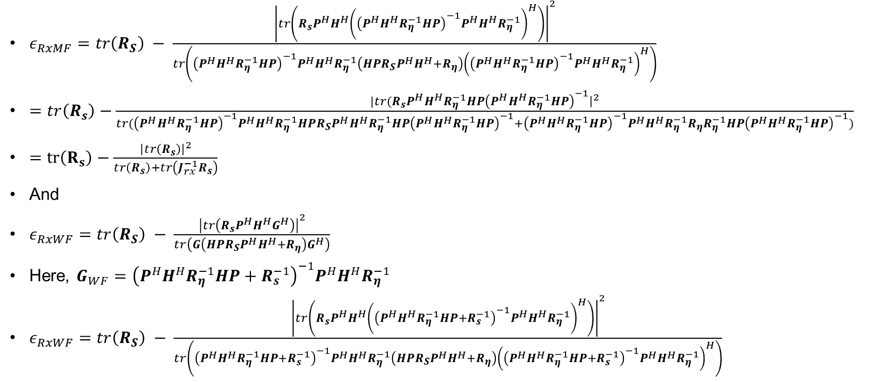
Receive Filters
$ε_{RxMF}=tr\left(R_{S}\right) − \frac{{\left|tr\left(R_{s}P^{H}H^{H}{\left({\left(P^{H}H^{H}R_{η}^{−1}HP\right)}^{−1}P^{H}H^{H}R_{η}^{−1}\right)}^{H}\right)\right|}^{2}}{tr\left({\left(P^{H}H^{H}R_{η}^{−1}HP\right)}^{−1}P^{H}H^{H}R_{η}^{−1}\left(HPR_{S}P^{H}H^{H}+R_{η}\right){\left({\left(P^{H}H^{H}R_{η}^{−1}HP\right)}^{−1}P^{H}H^{H}R_{η}^{−1}\right)}^{H}\right)}$
$=tr\left(R_{s}\right)−\frac{|tr(R_{s}P^{H}H^{H}R_{η}^{−1}HP{\left(P^{H}H^{H}R_{η}^{−1}HP\right)}^{−1}{\left.​\right|}^{2}}{tr({\left(P^{H}H^{H}R_{η}^{−1}HP\right)}^{−1}P^{H}H^{H}R_{η}^{−1}HPR_{S}P^{H}H^{H}R_{η}^{−1}HP{\left(P^{H}H^{H}R_{η}^{−1}HP\right)}^{−1}+{\left(P^{H}H^{H}R_{η}^{−1}HP\right)}^{−1}P^{H}H^{H}R_{η}^{−1}R_{η}R_{η}^{−1}HP{\left(P^{H}H^{H}R_{η}^{−1}HP\right)}^{−1})}$
$=tr\left(R_{s}\right)−\frac{{\left|tr\left(R_{s}\right)\right|}^{2}}{tr\left(R_{s}\right)+tr\left(J_{rx}^{−1}R_{s}\right)}$
And
$ε_{RxWF}=tr\left(R_{S}\right) − \frac{{\left|tr\left(R_{s}P^{H}H^{H}G^{H}\right)\right|}^{2}}{tr\left(G\left(HPR_{S}P^{H}H^{H}+R_{η}\right)G^{H}\right)}$
Here, $G_{WF}={\left(P^{H}H^{H}R_{η}^{−1}HP+R_{s}^{−1}\right)}^{−1}P^{H}H^{H}R_{η}^{−1}$
$ε_{RxWF}=tr\left(R_{S}\right) − \frac{{\left|tr\left(R_{s}P^{H}H^{H}{\left({\left(P^{H}H^{H}R_{η}^{−1}HP+R_{s}^{−1}\right)}^{−1}P^{H}H^{H}R_{η}^{−1}\right)}^{H}\right)\right|}^{2}}{tr\left({\left(P^{H}H^{H}R_{η}^{−1}HP+R_{s}^{−1}\right)}^{−1}P^{H}H^{H}R_{η}^{−1}\left(HPR_{S}P^{H}H^{H}+R_{η}\right){\left({\left(P^{H}H^{H}R_{η}^{−1}HP+R_{s}^{−1}\right)}^{−1}P^{H}H^{H}R_{η}^{−1}\right)}^{H}\right)}$

Slide 15
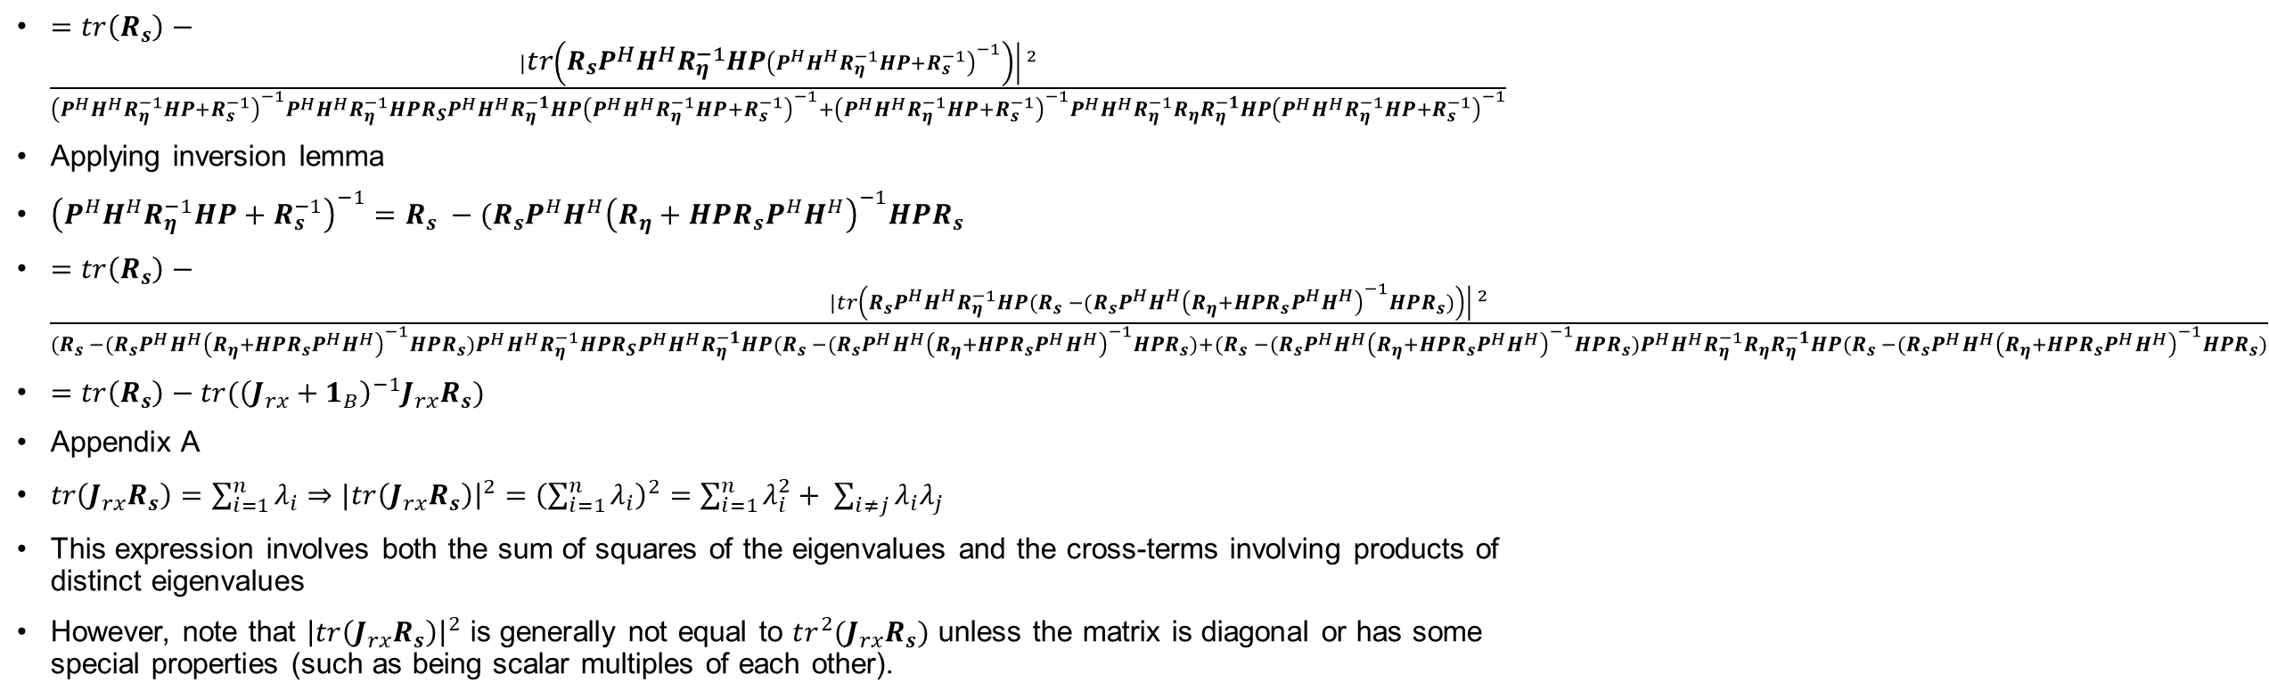
Receive Filters
$=tr\left(R_{s}\right)−\frac{|{\left.​tr\left(R_{s}P^{H}H^{H}R_{η}^{−1}HP{\left(P^{H}H^{H}R_{η}^{−1}HP+R_{s}^{−1}\right)}^{−1}\right)\right| }^{2}}{{\left(P^{H}H^{H}R_{η}^{−1}HP+R_{s}^{−1}\right)}^{−1}P^{H}H^{H}R_{η}^{−1}HPR_{S}P^{H}H^{H}R_{η}^{−1}HP{\left(P^{H}H^{H}R_{η}^{−1}HP+R_{s}^{−1}\right)}^{−1}+{\left(P^{H}H^{H}R_{η}^{−1}HP+R_{s}^{−1}\right)}^{−1}P^{H}H^{H}R_{η}^{−1}R_{η}R_{η}^{−1}HP{\left(P^{H}H^{H}R_{η}^{−1}HP+R_{s}^{−1}\right)}^{−1}}$
Applying inversion lemma
${\left(P^{H}H^{H}R_{η}^{−1}HP+R_{s}^{−1}\right)}^{−1}=R_{s} −(R_{s}P^{H}H^{H}{\left(R_{η}+HPR_{s}P^{H}H^{H}\right)}^{−1}HPR_{s}$
$=tr\left(R_{s}\right)−\frac{|{\left.​tr\left(R_{s}P^{H}H^{H}R_{η}^{−1}HP(R_{s} −(R_{s}P^{H}H^{H}{\left(R_{η}+HPR_{s}P^{H}H^{H}\right)}^{−1}HPR_{s})\right)\right| }^{2}}{(R_{s} −(R_{s}P^{H}H^{H}{\left(R_{η}+HPR_{s}P^{H}H^{H}\right)}^{−1}HPR_{s})P^{H}H^{H}R_{η}^{−1}HPR_{S}P^{H}H^{H}R_{η}^{−1}HP(R_{s} −(R_{s}P^{H}H^{H}{\left(R_{η}+HPR_{s}P^{H}H^{H}\right)}^{−1}HPR_{s})+(R_{s} −(R_{s}P^{H}H^{H}{\left(R_{η}+HPR_{s}P^{H}H^{H}\right)}^{−1}HPR_{s})P^{H}H^{H}R_{η}^{−1}R_{η}R_{η}^{−1}HP(R_{s} −(R_{s}P^{H}H^{H}{\left(R_{η}+HPR_{s}P^{H}H^{H}\right)}^{−1}HPR_{s})}$
$=tr\left(R_{s}\right)−tr({\left(J_{rx}+1_{B}\right)}^{−1}J_{rx}R_{s})$
Appendix A
$tr\left(J_{rx}R_{s}\right)=\sum_{i=1}^{n}{λ_{i}}⇒|{tr\left(J_{rx}R_{s}\right)\left.​\right|}^{2}={\left(\sum_{i=1}^{n}{λ_{i}}\right)}^{2}=\sum_{i=1}^{n}{λ_{i}^{2}+ \sum_{i≠j}{λ_{i}λ_{j}}}$
This expression involves both the sum of squares of the eigenvalues and the cross-terms involving products of distinct eigenvalues
However, note that ${\left|tr\left(J_{rx}R_{s}\right)\right|}^{2}$ is generally not equal to $tr^{2}(J_{rx}R_{s})$ unless the matrix is diagonal or has some special properties (such as being scalar multiples of each other).

Slide 16
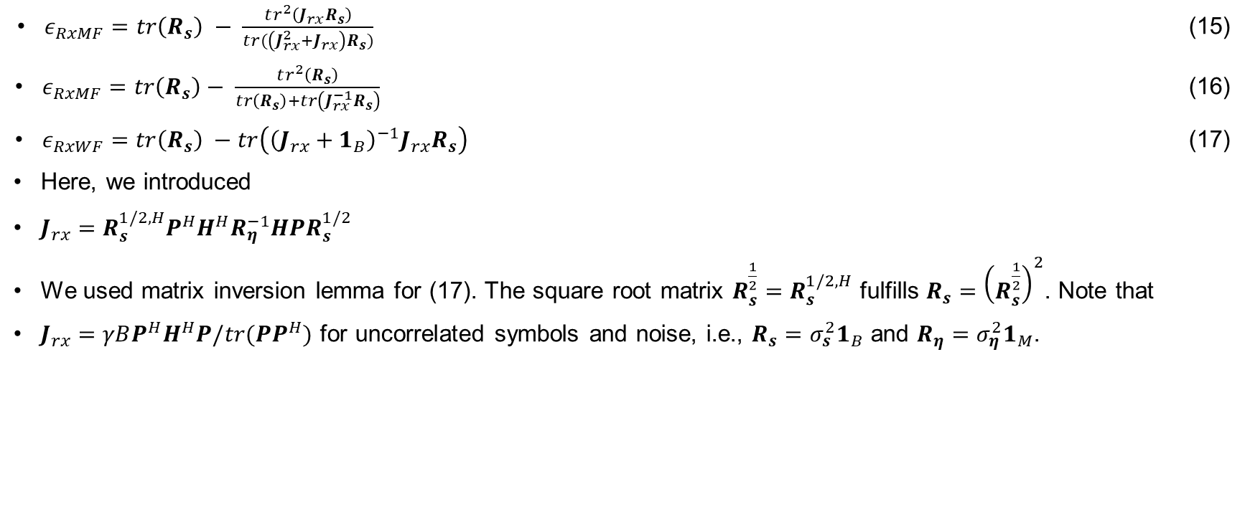
Receive Filters
$ε_{RxMF}=tr\left(R_{s}\right) − \frac{tr^{2}\left(J_{rx}R_{s}\right)}{tr(\left(J_{rx}^{2}+J_{rx}\right)R_{s})}$ (15)
$ε_{RxMF}=tr\left(R_{s}\right)− \frac{tr^{2}\left(R_{s}\right)}{tr\left(R_{s}\right)+tr\left(J_{rx}^{−1}R_{s}\right)}$ (16)
$ε_{RxWF}=tr\left(R_{s}\right) −tr\left({\left(J_{rx}+1_{B}\right)}^{−1}J_{rx}R_{s}\right)$ (17)
Here, we introduced
$J_{rx}=R_{s}^{1/2,H}P^{H}H^{H}R_{η}^{−1}HPR_{s}^{1/2}$
We used matrix inversion lemma for (17). The square root matrix $R_{s}^{\frac{1}{2}}=R_{s}^{1/2,H}$ fulfills $R_{s}={\left(R_{s}^{\frac{1}{2}}\right)}^{2}$. Note that
$J_{rx}=γBP^{H}H^{H}P/tr(PP^{H})$ for uncorrelated symbols and noise, i.e., $R_{s}=σ_{s}^{2}1_{B}$ and $R_{η}=σ_{η}^{2}1_{M}$.

Slide 17
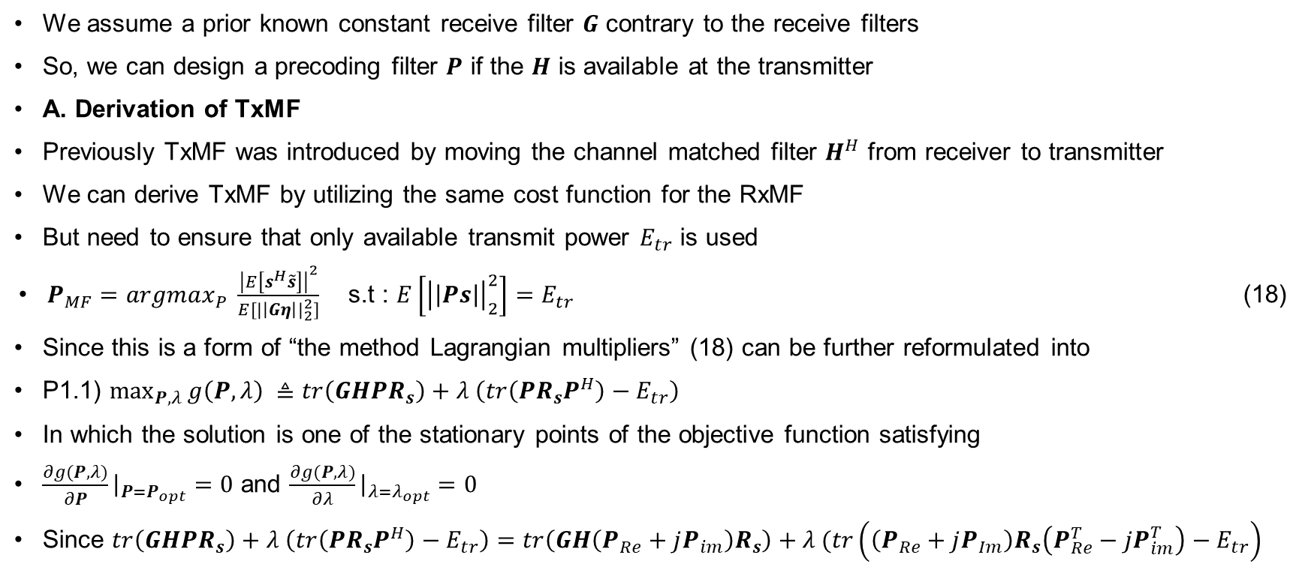
Transmit Matched Filter (TxMF)
We assume a prior known constant receive filter $G$ contrary to the receive filters
So, we can design a precoding filter $P$ if the $H$ is available at the transmitter
A. Derivation of TxMF
Previously TxMF was introduced by moving the channel matched filter $H^{H}$ from receiver to transmitter
We can derive TxMF by utilizing the same cost function for the RxMF
But need to ensure that only available transmit power $E_{tr}$ is used
$P_{MF}=argmax_{P} \frac{{\left|E\left[s^{H}\tilde{s}\right]\right|}^{2}}{E[{|\left|Gη\right||}_{2}^{2}]}$ s.t : $E\left[{\left|\left|Ps\right|\right|}_{2}^{2}\right]=E_{tr}$ (18)
Since this is a form of “the method Lagrangian multipliers” (18) can be further reformulated into
P1.1) $\max_{P,λ}{g\left(P,λ\right) ≜tr\left(GHPR_{s}\right)+λ \left(tr\left(PR_{s}P^{H}\right)−E_{tr}\right) }$
In which the solution is one of the stationary points of the objective function satisfying
$\frac{∂g(P,λ)}{∂P}{\left.​\right|}_{P=P_{opt}}=0$ and $\frac{∂g(P,λ)}{∂λ}{\left.​\right|}_{λ=λ_{opt}}=0$
Since $tr\left(GHPR_{s}\right)+λ \left(tr\left(PR_{s}P^{H}\right)−E_{tr}\right)=tr\left(GH\left(P_{Re}+jP_{im}\right)R_{s}\right)+λ (tr\left(\left(P_{Re}+jP_{Im}\right)R_{s}\left(P_{Re}^{T}−jP_{im}^{T}\right)−E_{tr}\right)$

Slide 18
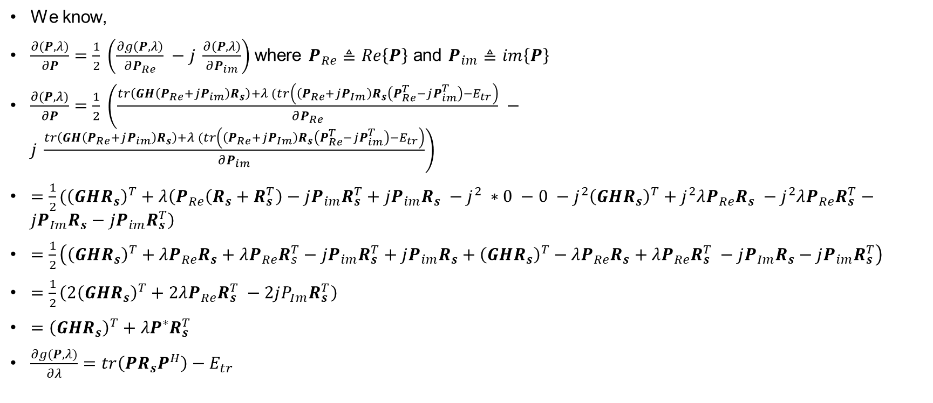
Transmit Matched Filter (TxMF)
We know,
$\frac{∂(P,λ)}{∂P}=\frac{1}{2} \left(\frac{∂g\left(P,λ\right)}{∂P_{Re}} −j \frac{∂\left(P,λ\right)}{∂P_{im}}\right)$where $P_{Re}≜Re\left\{P\right\}$ and $P_{im}≜im\left\{P\right\}$
$\frac{∂(P,λ)}{∂P}=\frac{1}{2} \left(\frac{tr\left(GH\left(P_{Re}+jP_{im}\right)R_{s}\right)+λ (tr\left(\left(P_{Re}+jP_{Im}\right)R_{s}\left(P_{Re}^{T}−jP_{im}^{T}\right)−E_{tr}\right)}{∂P_{Re}} −j \frac{tr\left(GH\left(P_{Re}+jP_{im}\right)R_{s}\right)+λ (tr\left(\left(P_{Re}+jP_{Im}\right)R_{s}\left(P_{Re}^{T}−jP_{im}^{T}\right)−E_{tr}\right)}{∂P_{im}}\right)$
$=\frac{1}{2}({\left(GHR_{s}\right)}^{T}+λ\left(P_{Re}\left(R_{s}+R_{s}^{T}\right)−jP_{im}R_{s}^{T}+jP_{im}R_{s} −j^{2} ∗0 −0 −j^{2}{\left(GHR_{s}\right)}^{T}+j^{2}λP_{Re}R_{s} −j^{2}λP_{Re}R_{s}^{T}−jP_{Im}R_{s}−jP_{im}R_{s}^{T}\right)$
$=\frac{1}{2}\left({\left(GHR_{s}\right)}^{T}+λP_{Re}R_{s}+λP_{Re}R_{s}^{T}−jP_{im}R_{s}^{T}+jP_{im}R_{s}+{\left(GHR_{s}\right)}^{T}−λP_{Re}R_{s}+λP_{Re}R_{s}^{T} −jP_{Im}R_{s}−jP_{im}R_{s}^{T}\right)$
$=\frac{1}{2}\left(2{\left(GHR_{s}\right)}^{T}+2λP_{Re}R_{s}^{T} −2jP_{Im}R_{s}^{T}\right)$
$={\left(GHR_{s}\right)}^{T}+λP^{∗}R_{s}^{T}$
$\frac{∂g(P,λ)}{∂λ}=tr\left(PR_{s}P^{H}\right)−E_{tr}$

Slide 19

Transmit Matched Filter (TxMF)
By letting,
$\frac{∂g(P,λ)}{∂P}{\left.​\right|}_{P=P_{opt}}=0$
$⇒{\left(GHR_{s}\right)}^{T}+λP^{∗}R_{s}^{T}=0$
$⇒λP^{∗}R_{s}^{T}=−{\left(GHR_{s}\right)}^{T}$
$⇒P^{∗}=−\frac{1}{λ}{\left(GHR_{s}\right)}^{T}{\left(R_{s}^{T}\right)}^{−1}$
$⇒P^{∗}=−\frac{1}{λ}{\left(R_{s}^{−1}GHR_{s}\right)}^{T}$
$⇒P= −\frac{1}{λ}{\left(R_{s}^{−1}GHR_{s}\right)}^{H}$
$⇒P=−\frac{1}{λ} H^{H}G^{H}$ (18)
Now, By letting
$\frac{∂g(P,λ)}{∂λ}{\left.​\right|}_{λ=λ_{opt}}=0$
$tr\left(PR_{s}P^{H}\right)−E_{tr}=0⇒tr\left(−\frac{1}{λ} H^{H}G^{H}R_{s}−\frac{1}{λ}GH\right)=E_{tr}$
$⇒tr\left(\frac{1}{λ^{2}}H^{H}G^{H}R_{s}GH\right)=E_{tr}⇒\frac{1}{λ^{2}}= \frac{E_{tr}}{tr(H^{H}G^{H}R_{s}GH)}⇒β_{TxMF}= \sqrt{\frac{E_{tr}}{tr(H^{H}G^{H}R_{s}GH)}}$ (19)

Slide 20
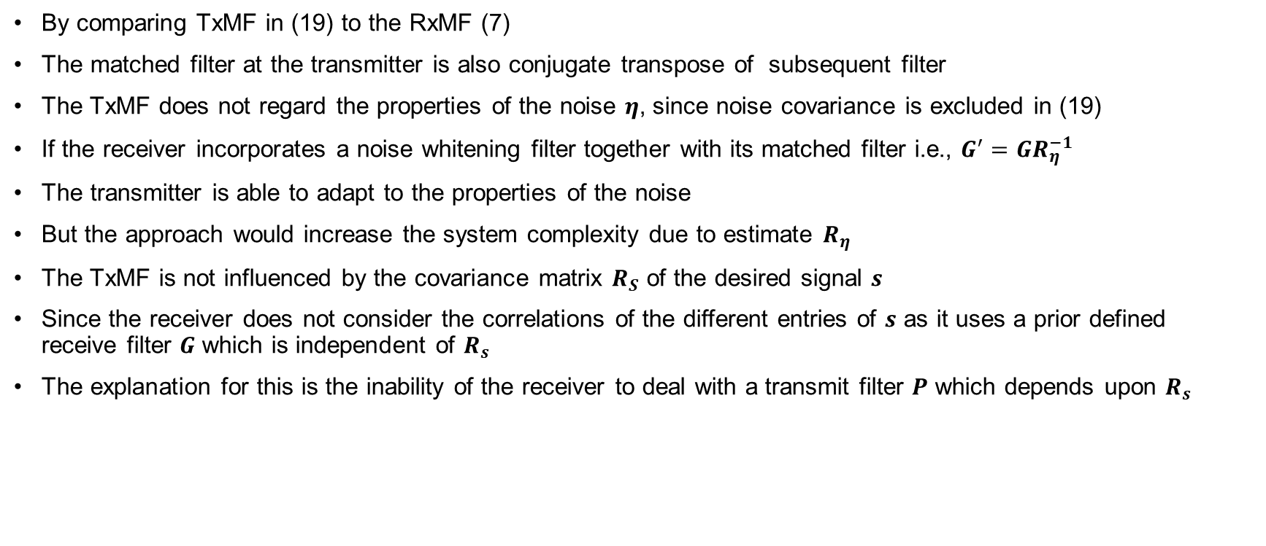
Transmit Matched Filter (TxMF)
By comparing TxMF in (19) to the RxMF (7)
The matched filter at the transmitter is also conjugate transpose of subsequent filter
The TxMF does not regard the properties of the noise $η$, since noise covariance is excluded in (19)
If the receiver incorporates a noise whitening filter together with its matched filter i.e., $G^{′}=GR_{η}^{−1}$
The transmitter is able to adapt to the properties of the noise
But the approach would increase the system complexity due to estimate $R_{η}$
The TxMF is not influenced by the covariance matrix $R_{S}$ of the desired signal $s$
Since the receiver does not consider the correlations of the different entries of $s$ as it uses a prior defined receive filter $G$ which is independent of $R_{s}$
The explanation for this is the inability of the receiver to deal with a transmit filter $P$ which depends upon $R_{s}$

Slide 21
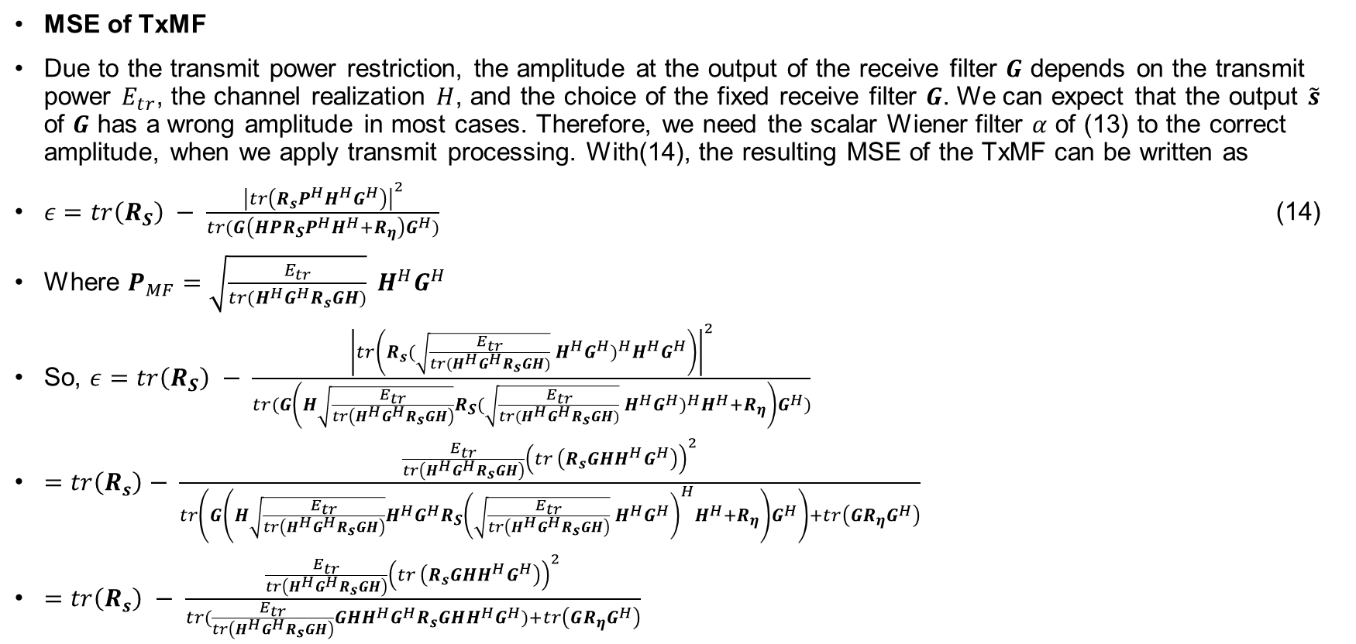
Transmit Matched Filter (TxMF)
MSE of TxMF
Due to the transmit power restriction, the amplitude at the output of the receive filter $G$ depends on the transmit power $E_{tr}$, the channel realization $H$, and the choice of the fixed receive filter $G$. We can expect that the output $\tilde{s}$ of $G$ has a wrong amplitude in most cases. Therefore, we need the scalar Wiener filter $α$ of (13) to the correct amplitude, when we apply transmit processing. With(14), the resulting MSE of the TxMF can be written as
$ε=tr\left(R_{S}\right) − \frac{{\left|tr\left(R_{s}P^{H}H^{H}G^{H}\right)\right|}^{2}}{tr(G\left(HPR_{S}P^{H}H^{H}+R_{η}\right)G^{H})}$ (14)
Where $P_{MF}=\sqrt{\frac{E_{tr}}{tr(H^{H}G^{H}R_{s}GH)}} H^{H}G^{H}$
So, $ε=tr\left(R_{S}\right) − \frac{{\left|tr\left(R_{s}{(\sqrt{\frac{E_{tr}}{tr(H^{H}G^{H}R_{s}GH)}} H^{H}G^{H})}^{H}H^{H}G^{H}\right)\right|}^{2}}{tr(G\left(H\sqrt{\frac{E_{tr}}{tr\left(H^{H}G^{H}R_{s}GH\right)}}R_{S}{(\sqrt{\frac{E_{tr}}{tr(H^{H}G^{H}R_{s}GH)}} H^{H}G^{H})}^{H}H^{H}+R_{η}\right)G^{H})}$
$=tr\left(R_{s}\right)− \frac{\frac{E_{tr}}{tr\left(H^{H}G^{H}R_{s}GH\right)}{\left(tr \left(R_{s}{GHH}^{H}G^{H}\right)\right)}^{2}}{tr\left(G\left(H\sqrt{\frac{E_{tr}}{tr\left(H^{H}G^{H}R_{s}GH\right)}}{H^{H}G^{H}R}_{S}{\left(\sqrt{\frac{E_{tr}}{tr\left(H^{H}G^{H}R_{s}GH\right)}} H^{H}G^{H}\right)}^{H}H^{H}+R_{η}\right)G^{H}\right)+tr\left(GR_{η}G^{H}\right)}$
$=tr\left(R_{s}\right) − \frac{\frac{E_{tr}}{tr\left(H^{H}G^{H}R_{s}GH\right)}{\left(tr \left(R_{s}{GHH}^{H}G^{H}\right)\right)}^{2}}{tr(\frac{E_{tr}}{tr\left(H^{H}G^{H}R_{s}GH\right)}GHH^{H}G^{H}R_{s}GHH^{H}G^{H})+tr\left(GR_{η}G^{H}\right)}$

Slide 22

Transmit Matched Filter (TxMF)
$=tr\left(R_{s}\right) − \frac{{\left(tr \left(R_{s}{GHH}^{H}G^{H}\right)\right)}^{2}}{tr(GHH^{H}G^{H}R_{s}GHH^{H}G^{H})+tr\left(GR_{η}G^{H}\right)}$
$=tr\left(R_{s}\right)− \frac{{\left(tr \left(R_{s}{GHH}^{H}G^{H}\right)\frac{E_{tr}}{tr\left(GR_{η}G^{H}\right)}\right)}^{2}}{tr(GHH^{H}G^{H}\frac{E_{tr}}{tr\left(GR_{η}G^{H}\right)}R_{s}GHH^{H}G^{H}\frac{E_{tr}}{tr\left(GR_{η}G^{H}\right)})+tr \left(R_{s}{GHH}^{H}G^{H}\right)\frac{E_{tr}}{tr\left(GR_{η}G^{H}\right)}tr\left(GR_{η}G^{H}\right)}$
Where we introduced
$J_{tx}=GHH^{H}G^{H}\frac{E_{tr}}{tr({GR_{η}G}^{H})}$
$ε_{TxMF}=tr\left(R_{s}\right)−\frac{tr^{2}\left(J_{tx}R_{s}\right)}{tr\left(\left(J_{tx}^{2}+J_{tx}\right)R_{s}\right)}$ (20)

Slide 23
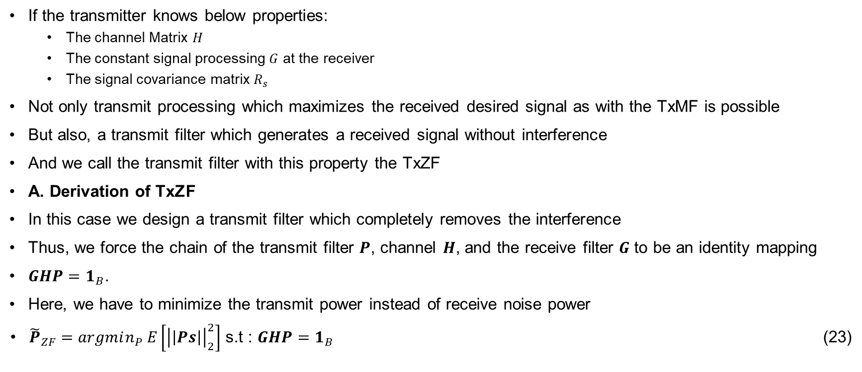
Transmit zero forcing filter
If the transmitter knows below properties:
The channel Matrix $H$
The constant signal processing $G$ at the receiver
The signal covariance matrix $R_{s}$
Not only transmit processing which maximizes the received desired signal as with the TxMF is possible
But also, a transmit filter which generates a received signal without interference
And we call the transmit filter with this property the TxZF
A. Derivation of TxZF
In this case we design a transmit filter which completely removes the interference
Thus, we force the chain of the transmit filter $P$, channel $H$, and the receive filter $G$ to be an identity mapping
$GHP=1_{B}$.
Here, we have to minimize the transmit power instead of receive noise power
${\tilde{P}}_{ZF}=argmin_{P} E\left[{\left|\left|Ps\right|\right|}_{2}^{2}\right]$ s.t : $GHP=1_{B}$ (23)

Slide 24
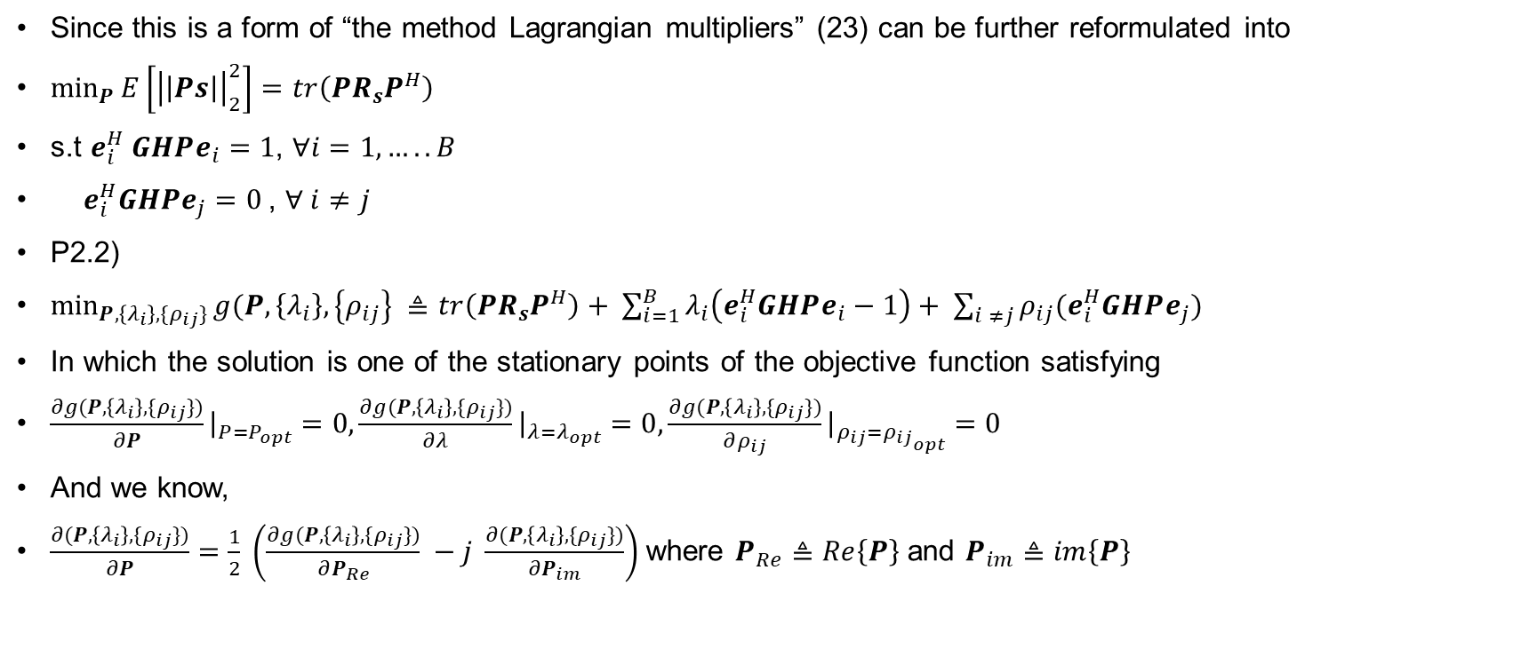
Transmit zero forcing filter
Since this is a form of “the method Lagrangian multipliers” (23) can be further reformulated into
$\min_{P}{E\left[{\left|\left|Ps\right|\right|}_{2}^{2}\right]=tr\left(PR_{s}P^{H}\right)}$
s.t $e_{i}^{H} GHPe_{i}=1$, $∀i=1,…..B$
$e_{i}^{H}GHPe_{j}=0$, $∀ i≠j$
P2.2)
$\min_{P,\left\{λ_{i}\right\},\{ρ_{ij}\}}{g(P,\left\{λ_{i}\right\},\left\{ρ_{ij}\right\} ≜tr\left(PR_{s}P^{H}\right)+ \sum_{i=1}^{B}{λ_{i}\left(e_{i}^{H}GHPe_{i}−1\right)+ \sum_{i ≠j}{ρ_{ij}(e_{i}^{H}GHPe_{j})}}}$
In which the solution is one of the stationary points of the objective function satisfying
$\frac{∂g(P,\left\{λ_{i}\right\},\{ρ_{ij}\})}{∂P}{\left.​\right|}_{P=P_{opt}}=0,\frac{∂g(P,\left\{λ_{i}\right\},\{ρ_{ij}\})}{∂λ}{\left.​\right|}_{λ=λ_{opt}}=0,\frac{∂g(P,\left\{λ_{i}\right\},\{ρ_{ij}\})}{∂ρ_{ij}}{\left.​\right|}_{ρ_{ij}={ρ_{ij}}_{opt}}=0$
And we know,
$\frac{∂(P,\left\{λ_{i}\right\},\{ρ_{ij}\})}{∂P}=\frac{1}{2} \left(\frac{∂g(P,\left\{λ_{i}\right\},\{ρ_{ij}\})}{∂P_{Re}} −j \frac{∂(P,\left\{λ_{i}\right\},\{ρ_{ij}\})}{∂P_{im}}\right)$where $P_{Re}≜Re\left\{P\right\}$ and $P_{im}≜im\left\{P\right\}$

Slide 25
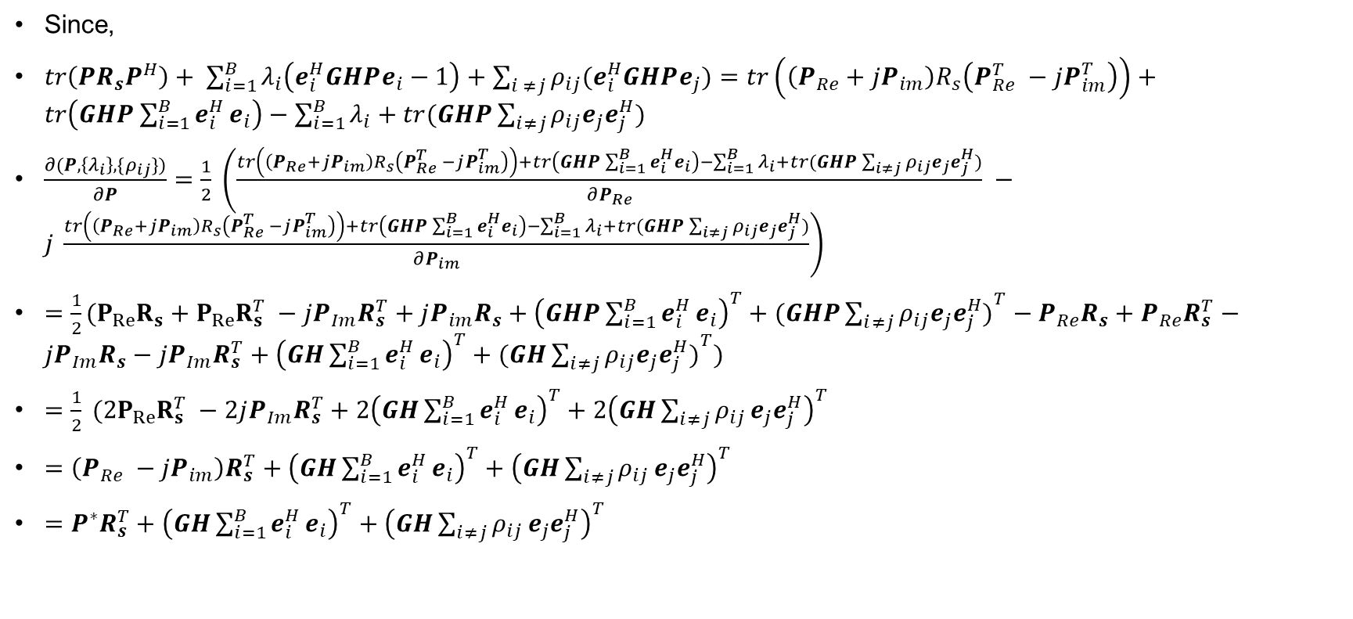
Transmit zero forcing filter
Since,
$tr\left(PR_{s}P^{H}\right)+ \sum_{i=1}^{B}{λ_{i}\left(e_{i}^{H}GHPe_{i}−1\right)+\sum_{i ≠j}{ρ_{ij}(e_{i}^{H}GHPe_{j})}=tr\left(\left(P_{Re}+jP_{im}\right)R_{s}\left(P_{Re}^{T} −jP_{im}^{T}\right)\right)}+tr\left(GHP\sum_{i=1}^{B}{e_{i}^{H}}e_{i}\right)−\sum_{i=1}^{B}{λ_{i}}+tr(GHP\sum_{i≠j}{ρ_{ij}e_{j}e_{j}^{H})}$
$\frac{∂(P,\left\{λ_{i}\right\},\{ρ_{ij}\})}{∂P}=\frac{1}{2} \left(\frac{tr\left(\left(P_{Re}+jP_{im}\right)R_{s}\left(P_{Re}^{T} −jP_{im}^{T}\right)\right)+tr\left(GHP\sum_{i=1}^{B}{e_{i}^{H}}e_{i}\right)−\sum_{i=1}^{B}{λ_{i}}+tr(GHP\sum_{i≠j}{ρ_{ij}e_{j}e_{j}^{H})}}{∂P_{Re}} −j \frac{tr\left(\left(P_{Re}+jP_{im}\right)R_{s}\left(P_{Re}^{T} −jP_{im}^{T}\right)\right)+tr\left(GHP\sum_{i=1}^{B}{e_{i}^{H}}e_{i}\right)−\sum_{i=1}^{B}{λ_{i}}+tr(GHP\sum_{i≠j}{ρ_{ij}e_{j}e_{j}^{H})}}{∂P_{im}}\right)$
$={\frac{1}{2}(P}_{Re}R_{s}+P_{Re}R_{s}^{T} −jP_{Im}R_{s}^{T}+jP_{im}R_{s}+{\left(GHP\sum_{i=1}^{B}{e_{i}^{H}}e_{i}\right)}^{T}+(GHP{\sum_{i≠j}{ρ_{ij}e_{j}e_{j}^{H})}}^{T}−P_{Re}R_{s}+P_{Re}R_{s}^{T}−jP_{Im}R_{s}−jP_{Im}R_{s}^{T}+{\left(GH\sum_{i=1}^{B}{e_{i}^{H}}e_{i}\right)}^{T}+(GH{\sum_{i≠j}{ρ_{ij}e_{j}e_{j}^{H})}}^{T})$
$=\frac{1}{2} (2P_{Re}R_{s}^{T} −2jP_{Im}R_{s}^{T}+2{\left(GH\sum_{i=1}^{B}{e_{i}^{H}}e_{i}\right)}^{T}+2{\left(GH\sum_{i≠j}{ρ_{ij}}e_{j}e_{j}^{H}\right)}^{T}$
$=\left(P_{Re} −jP_{im}\right)R_{s}^{T}+{\left(GH\sum_{i=1}^{B}{e_{i}^{H}}e_{i}\right)}^{T}+{\left(GH\sum_{i≠j}{ρ_{ij}}e_{j}e_{j}^{H}\right)}^{T}$
$=P^{∗}R_{s}^{T}+{\left(GH\sum_{i=1}^{B}{e_{i}^{H}}e_{i}\right)}^{T}+{\left(GH\sum_{i≠j}{ρ_{ij}}e_{j}e_{j}^{H}\right)}^{T}$

Slide 26
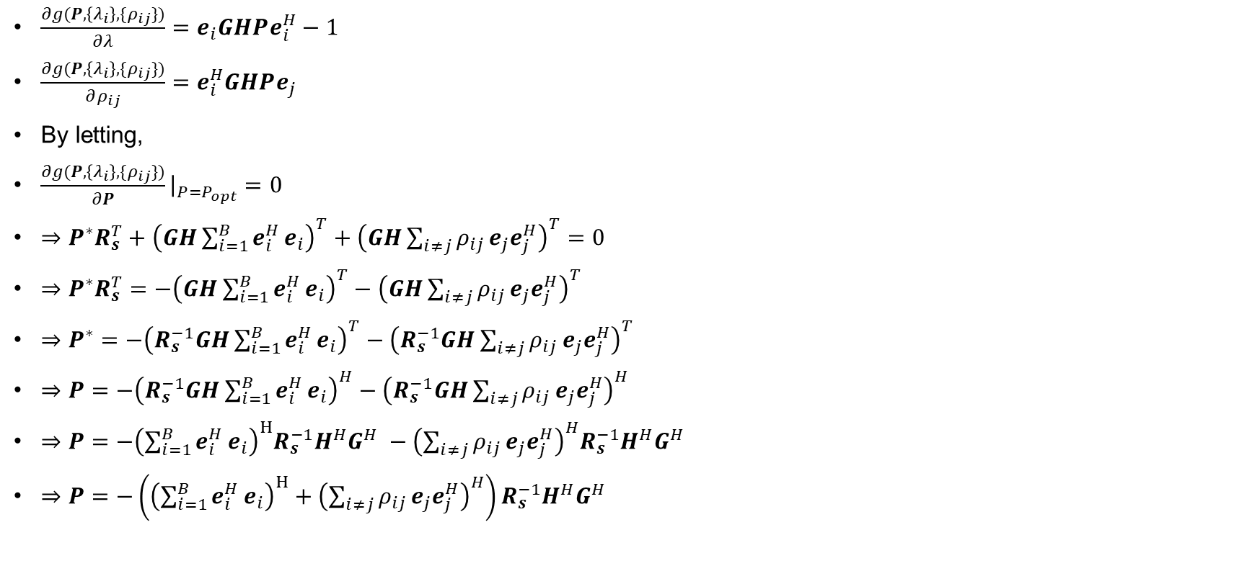
Transmit zero forcing filter
$\frac{∂g(P,\left\{λ_{i}\right\},\{ρ_{ij}\})}{∂λ}=e_{i}GHPe_{i}^{H}−1$
$\frac{∂g(P,\left\{λ_{i}\right\},\{ρ_{ij}\})}{∂ρ_{ij}}=e_{i}^{H}GHPe_{j}$
By letting,
$\frac{∂g(P,\left\{λ_{i}\right\},\{ρ_{ij}\})}{∂P}{\left.​\right|}_{P=P_{opt}}=0$
$⇒P^{∗}R_{s}^{T}+{\left(GH\sum_{i=1}^{B}{e_{i}^{H}}e_{i}\right)}^{T}+{\left(GH\sum_{i≠j}{ρ_{ij}}e_{j}e_{j}^{H}\right)}^{T}=0$
$⇒P^{∗}R_{s}^{T}=−{\left(GH\sum_{i=1}^{B}{e_{i}^{H}}e_{i}\right)}^{T}−{\left(GH\sum_{i≠j}{ρ_{ij}}e_{j}e_{j}^{H}\right)}^{T}$
$⇒P^{∗}=−{\left(R_{s}^{−1}GH\sum_{i=1}^{B}{e_{i}^{H}}e_{i}\right)}^{T}−{\left(R_{s}^{−1}GH\sum_{i≠j}{ρ_{ij}}e_{j}e_{j}^{H}\right)}^{T}$
$⇒P=−{\left(R_{s}^{−1}GH\sum_{i=1}^{B}{e_{i}^{H}}e_{i}\right)}^{H}−{\left(R_{s}^{−1}GH\sum_{i≠j}{ρ_{ij}}e_{j}e_{j}^{H}\right)}^{H}$
$⇒P=−{\left(\sum_{i=1}^{B}{e_{i}^{H}}e_{i}\right)}^{H}R_{s}^{−1}H^{H}G^{H} −{\left(\sum_{i≠j}{ρ_{ij}}e_{j}e_{j}^{H}\right)}^{H}R_{s}^{−1}H^{H}G^{H}$
$⇒P=−\left({\left(\sum_{i=1}^{B}{e_{i}^{H}}e_{i}\right)}^{H}+{\left(\sum_{i≠j}{ρ_{ij}}e_{j}e_{j}^{H}\right)}^{H}\right)R_{s}^{−1}H^{H}G^{H}$

Slide 27
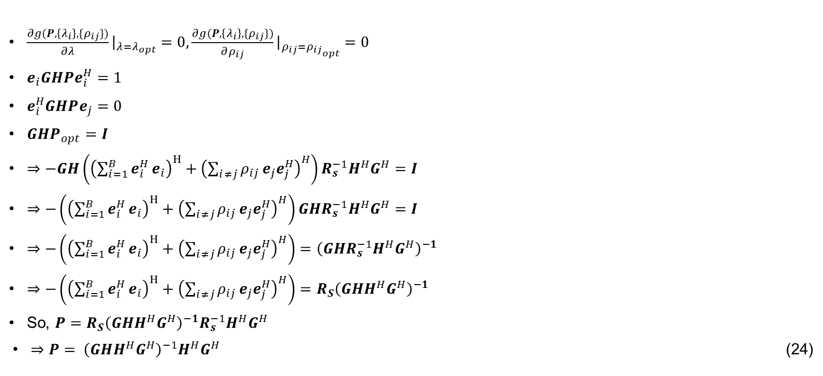
Transmit zero forcing filter
$\frac{∂g(P,\left\{λ_{i}\right\},\{ρ_{ij}\})}{∂λ}{\left.​\right|}_{λ=λ_{opt}}=0,\frac{∂g(P,\left\{λ_{i}\right\},\{ρ_{ij}\})}{∂ρ_{ij}}{\left.​\right|}_{ρ_{ij}={ρ_{ij}}_{opt}}=0$
$e_{i}GHPe_{i}^{H}=1$
$e_{i}^{H}GHPe_{j}=0$
$GHP_{opt}=I$
$⇒−GH\left({\left(\sum_{i=1}^{B}{e_{i}^{H}}e_{i}\right)}^{H}+{\left(\sum_{i≠j}{ρ_{ij}}e_{j}e_{j}^{H}\right)}^{H}\right)R_{s}^{−1}H^{H}G^{H}=I$
$⇒−\left({\left(\sum_{i=1}^{B}{e_{i}^{H}}e_{i}\right)}^{H}+{\left(\sum_{i≠j}{ρ_{ij}}e_{j}e_{j}^{H}\right)}^{H}\right)GHR_{s}^{−1}H^{H}G^{H}=I$
$⇒−\left({\left(\sum_{i=1}^{B}{e_{i}^{H}}e_{i}\right)}^{H}+{\left(\sum_{i≠j}{ρ_{ij}}e_{j}e_{j}^{H}\right)}^{H}\right)={\left(GHR_{s}^{−1}H^{H}G^{H}\right)}^{−1}$
$⇒−\left({\left(\sum_{i=1}^{B}{e_{i}^{H}}e_{i}\right)}^{H}+{\left(\sum_{i≠j}{ρ_{ij}}e_{j}e_{j}^{H}\right)}^{H}\right)={R_{S}\left(GHH^{H}G^{H}\right)}^{−1}$
So, $P={R_{S}\left(GHH^{H}G^{H}\right)}^{−1}R_{s}^{−1}H^{H}G^{H}$
$⇒P= {\left(GHH^{H}G^{H}\right)}^{−1}H^{H}G^{H}$ (24)

Slide 28
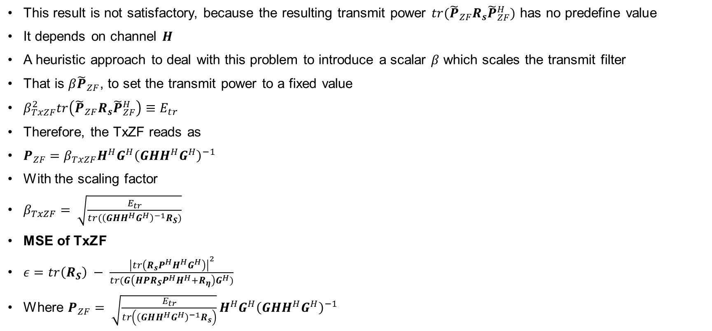
Transmit zero forcing filter
This result is not satisfactory, because the resulting transmit power $tr({\tilde{P}}_{ZF}R_{s}{\tilde{P}}_{ZF}^{H})$ has no predefine value
It depends on channel $H$
A heuristic approach to deal with this problem to introduce a scalar $β$ which scales the transmit filter
That is $β{\tilde{P}}_{ZF}$, to set the transmit power to a fixed value
$β_{TxZF}^{2}tr\left({\tilde{P}}_{ZF}R_{s}{\tilde{P}}_{ZF}^{H}\right)≡E_{tr}$
Therefore, the TxZF reads as
$P_{ZF}=β_{TxZF}H^{H}G^{H}{\left(GHH^{H}G^{H}\right)}^{−1}$
With the scaling factor
$β_{TxZF}= \sqrt{\frac{E_{tr}}{tr({\left(GHH^{H}G^{H}\right)}^{−1}R_{S})}}$
MSE of TxZF
$ε=tr\left(R_{S}\right) − \frac{{\left|tr\left(R_{s}P^{H}H^{H}G^{H}\right)\right|}^{2}}{tr(G\left(HPR_{S}P^{H}H^{H}+R_{η}\right)G^{H})}$
Where $P_{ZF}= \sqrt{\frac{E_{tr}}{tr\left({\left(GHH^{H}G^{H}\right)}^{−1}R_{s}\right)}}H^{H}G^{H}{\left(GHH^{H}G^{H}\right)}^{−1}$

Slide 29

Transmit zero forcing filter
MSE of TxZF
$ε=tr\left(R_{S}\right) − \frac{{\left|tr\left(R_{s}{(\sqrt{\frac{E_{tr}}{tr\left({\left(GHH^{H}G^{H}\right)}^{−1}R_{s}\right)}}H^{H}G^{H}{\left(GHH^{H}G^{H}\right)}^{−1})}^{H}H^{H}G^{H}\right)\right|}^{2}}{tr(G\left(H\sqrt{\frac{E_{tr}}{tr\left({\left(GHH^{H}G^{H}\right)}^{−1}R_{s}\right)}}H^{H}G^{H}{\left(GHH^{H}G^{H}\right)}^{−1}R_{S}{(\sqrt{\frac{E_{tr}}{tr\left({\left(GHH^{H}G^{H}\right)}^{−1}R_{s}\right)}}H^{H}G^{H}{\left(GHH^{H}G^{H}\right)}^{−1})}^{H}H^{H}+R_{η}\right)G^{H})}$
$=tr\left(R_{s}\right) − \frac{|{\left.​tr\left(R_{s}{\left(GHH^{H}G^{H}\right)}^{−1}GHH^{H}G^{H}\right)\right|}^{2}}{tr\left(GHH^{H}G^{H}{\left(GHH^{H}G^{H}\right)}^{−1}R_{s}{\left(GHH^{H}G^{H}\right)}^{−1}GHH^{H}G^{H}\right))+tr\left(GR_{η}G^{H}\right)}$
$=tr\left(R_{s}\right) − \frac{|{\left.​tr(R_{s})\right|}^{2}}{tr\left(R_{s}\right)+tr\left(GR_{η}G^{H}\right)}$

Slide 30
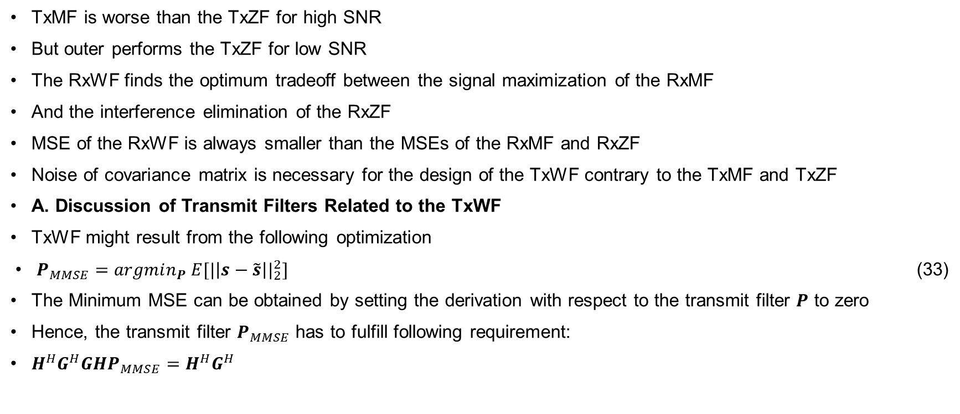
Transmit Wiener Filter (TxWF)
TxMF is worse than the TxZF for high SNR
But outer performs the TxZF for low SNR
The RxWF finds the optimum tradeoff between the signal maximization of the RxMF
And the interference elimination of the RxZF
MSE of the RxWF is always smaller than the MSEs of the RxMF and RxZF
Noise of covariance matrix is necessary for the design of the TxWF contrary to the TxMF and TxZF
A. Discussion of Transmit Filters Related to the TxWF
TxWF might result from the following optimization
$P_{MMSE}=argmin_{P} E[{|\left|s−\tilde{s}\right||}_{2}^{2}]$ (33)
The Minimum MSE can be obtained by setting the derivation with respect to the transmit filter $P$ to zero
Hence, the transmit filter $P_{MMSE}$ has to fulfill following requirement:
$H^{H}G^{H}GHP_{MMSE}=H^{H}G^{H}$

Slide 31
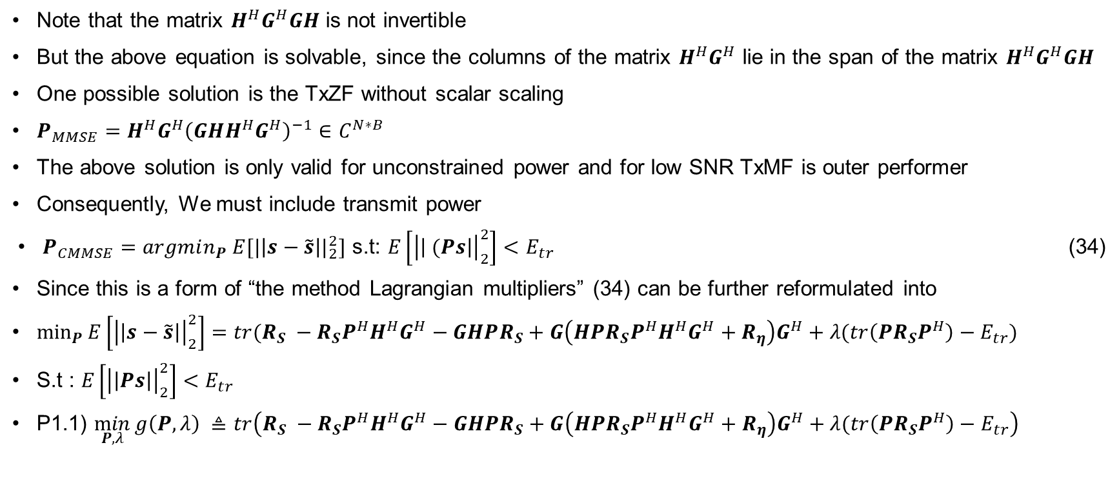
Transmit Wiener Filter (TxWF)
Note that the matrix $H^{H}G^{H}GH$ is not invertible
But the above equation is solvable, since the columns of the matrix $H^{H}G^{H}$ lie in the span of the matrix $H^{H}G^{H}GH$
One possible solution is the TxZF without scalar scaling
$P_{MMSE}=H^{H}G^{H}{\left(GHH^{H}G^{H}\right)}^{−1}∈C^{N∗B}$
The above solution is only valid for unconstrained power and for low SNR TxMF is outer performer
Consequently, We must include transmit power
$P_{CMMSE}=argmin_{P} E[{|\left|s−\tilde{s}\right||}_{2}^{2}]$ s.t: $E\left[{\left|\left| (Ps\right|\right|}_{2}^{2}\right]<E_{tr}$ (34)
Since this is a form of “the method Lagrangian multipliers” (34) can be further reformulated into
$\min_{P}{E\left[{\left|\left|s−\tilde{s}\right|\right|}_{2}^{2}\right]=tr(R_{S} −R_{S}P^{H}H^{H}G^{H}−GHPR_{S}+G\left(HPR_{S}P^{H}H^{H}G^{H}+R_{η}\right)G^{H}+λ(tr\left(PR_{S}P^{H}\right)−E_{tr})}$
S.t : $E\left[{\left|\left|Ps\right|\right|}_{2}^{2}\right]<E_{tr}$
P1.1) $\min_{P,λ}{g\left(P,λ\right) ≜tr\left(R_{S} −R_{S}P^{H}H^{H}G^{H}−GHPR_{S}+G\left(HPR_{S}P^{H}H^{H}G^{H}+R_{η}\right)G^{H}+λ(tr\left(PR_{S}P^{H}\right)−E_{tr}\right)}$

Slide 32
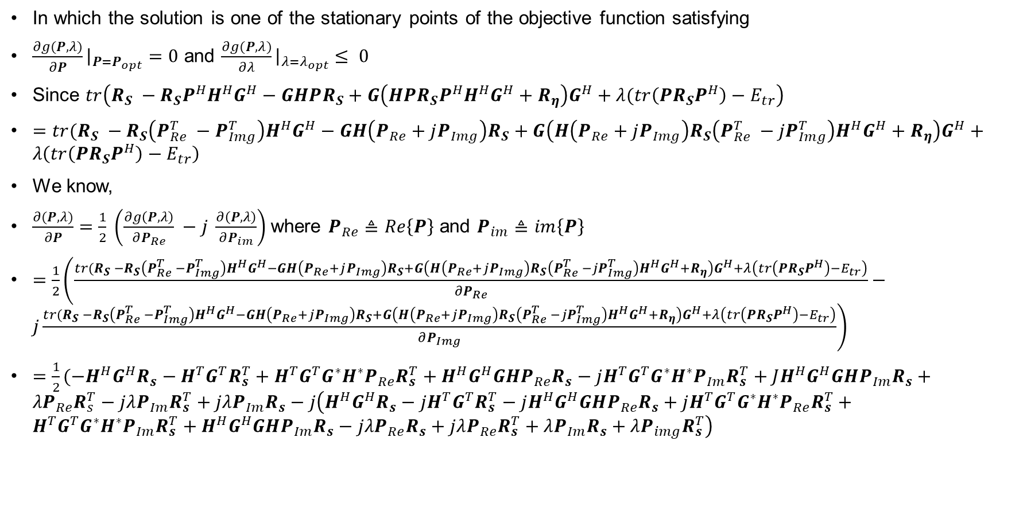
Transmit Wiener Filter (TxWF)
In which the solution is one of the stationary points of the objective function satisfying
$\frac{∂g(P,λ)}{∂P}{\left.​\right|}_{P=P_{opt}}=0$ and $\frac{∂g(P,λ)}{∂λ}{\left.​\right|}_{λ=λ_{opt}}≤ 0$
Since $tr\left(R_{S} −R_{S}P^{H}H^{H}G^{H}−GHPR_{S}+G\left(HPR_{S}P^{H}H^{H}G^{H}+R_{η}\right)G^{H}+λ(tr\left(PR_{S}P^{H}\right)−E_{tr}\right)$
$=tr(R_{S} −R_{S}\left(P_{Re}^{T} −P_{Img}^{T}\right)H^{H}G^{H}−GH\left(P_{Re}+jP_{Img}\right)R_{S}+G\left(H\left(P_{Re}+jP_{Img}\right)R_{S}\left(P_{Re}^{T} −{jP}_{Img}^{T}\right)H^{H}G^{H}+R_{η}\right)G^{H}+λ\left(tr\left(P{R_{S}P}^{H}\right)−E_{tr}\right)$
We know,
$\frac{∂(P,λ)}{∂P}=\frac{1}{2} \left(\frac{∂g\left(P,λ\right)}{∂P_{Re}} −j \frac{∂\left(P,λ\right)}{∂P_{im}}\right)$where $P_{Re}≜Re\left\{P\right\}$ and $P_{im}≜im\left\{P\right\}$
$=\frac{1}{2}\left(\frac{tr(R_{S} −R_{S}\left(P_{Re}^{T} −P_{Img}^{T}\right)H^{H}G^{H}−GH\left(P_{Re}+jP_{Img}\right)R_{S}+G\left(H\left(P_{Re}+jP_{Img}\right)R_{S}\left(P_{Re}^{T} −{jP}_{Img}^{T}\right)H^{H}G^{H}+R_{η}\right)G^{H}+λ\left(tr\left(PR_{S}P^{H}\right)−E_{tr}\right)}{∂P_{Re}}−j\frac{tr(R_{S} −R_{S}\left(P_{Re}^{T} −P_{Img}^{T}\right)H^{H}G^{H}−GH\left(P_{Re}+jP_{Img}\right)R_{S}+G\left(H\left(P_{Re}+jP_{Img}\right)R_{S}\left(P_{Re}^{T} −{jP}_{Img}^{T}\right)H^{H}G^{H}+R_{η}\right)G^{H}+λ\left(tr\left(PR_{S}P^{H}\right)−E_{tr}\right)}{∂P_{Img}}\right)$
$=\frac{1}{2}(−H^{H}G^{H}R_{s}−H^{T}G^{T}R_{s}^{T}+H^{T}G^{T}G^{∗}H^{∗}P_{Re}R_{s}^{T}+H^{H}G^{H}GHP_{Re}R_{s}−jH^{T}G^{T}G^{∗}H^{∗}P_{Im}R_{s}^{T}+JH^{H}G^{H}GHP_{Im}R_{s}+λP_{Re}R_{s}^{T}−jλP_{Im}R_{s}^{T}+jλP_{Im}R_{s}−j\left(H^{H}G^{H}R_{s}−jH^{T}G^{T}R_{s}^{T}−jH^{H}G^{H}GHP_{Re}R_{s}+jH^{T}G^{T}G^{∗}H^{∗}P_{Re}R_{s}^{T}+H^{T}G^{T}G^{∗}H^{∗}P_{Im}R_{s}^{T}+H^{H}G^{H}GHP_{Im}R_{s}−jλP_{Re}R_{s}+jλP_{Re}R_{s}^{T}+λP_{Im}R_{s}+λP_{img}R_{s}^{T}\right)$

Slide 33
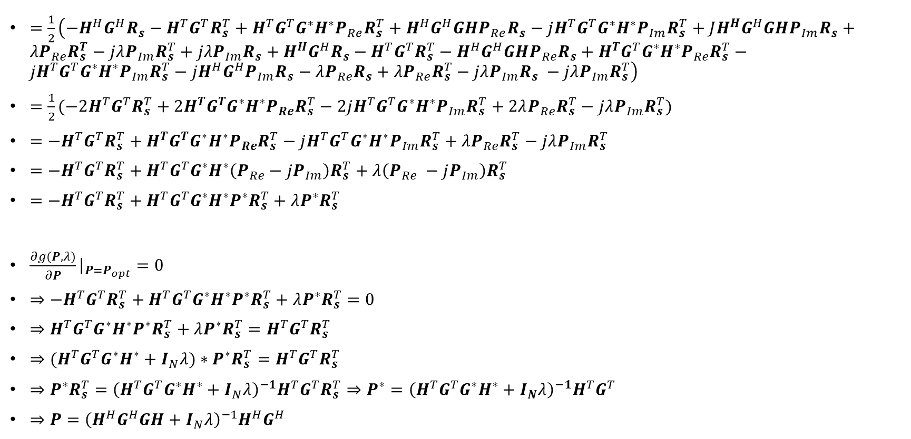
Transmit Wiener Filter (TxWF)
$=\frac{1}{2}\left({−H}^{H}G^{H}R_{s}−H^{T}G^{T}R_{s}^{T}+H^{T}G^{T}G^{∗}H^{∗}P_{Re}R_{s}^{T}+H^{H}G^{H}GHP_{Re}R_{s}−jH^{T}G^{T}G^{∗}H^{∗}P_{Im}R_{s}^{T}+JH^{H}G^{H}GHP_{Im}R_{s}+λP_{Re}R_{s}^{T}−jλP_{Im}R_{s}^{T}+jλP_{Im}R_{s}+H^{H}G^{H}R_{s}−H^{T}G^{T}R_{s}^{T}−H^{H}G^{H}GHP_{Re}R_{s}+H^{T}G^{T}G^{∗}H^{∗}P_{Re}R_{s}^{T}−jH^{T}G^{T}G^{∗}H^{∗}P_{Im}R_{s}^{T}−jH^{H}G^{H}P_{Im}R_{s}−λP_{Re}R_{s}+λP_{Re}R_{s}^{T}−jλP_{Im}R_{s} −jλP_{Im}R_{s}^{T}\right)$
$=\frac{1}{2}(−2H^{T}G^{T}R_{s}^{T}+2H^{T}G^{T}G^{∗}H^{∗}P_{Re}R_{s}^{T}−2jH^{T}G^{T}G^{∗}H^{∗}P_{Im}R_{s}^{T}+2λP_{Re}R_{s}^{T}−jλP_{Im}R_{s}^{T})$
$=−H^{T}G^{T}R_{s}^{T}+H^{T}G^{T}G^{∗}H^{∗}P_{Re}R_{s}^{T}−jH^{T}G^{T}G^{∗}H^{∗}P_{Im}R_{s}^{T}+λP_{Re}R_{s}^{T}−jλP_{Im}R_{s}^{T}$
$=−H^{T}G^{T}R_{s}^{T}+H^{T}G^{T}G^{∗}H^{∗}\left(P_{Re}−jP_{Im}\right)R_{s}^{T}+λ\left(P_{Re} −jP_{Im}\right)R_{s}^{T}$
$=−H^{T}G^{T}R_{s}^{T}+H^{T}G^{T}G^{∗}H^{∗}P^{∗}R_{s}^{T}+λP^{∗}R_{s}^{T}$
$\frac{∂g(P,λ)}{∂P}{\left.​\right|}_{P=P_{opt}}=0$
$⇒−H^{T}G^{T}R_{s}^{T}+H^{T}G^{T}G^{∗}H^{∗}P^{∗}R_{s}^{T}+λP^{∗}R_{s}^{T}=0$
$⇒H^{T}G^{T}G^{∗}H^{∗}P^{∗}R_{s}^{T}+λP^{∗}R_{s}^{T}=H^{T}G^{T}R_{s}^{T}$
$⇒{(H}^{T}G^{T}G^{∗}H^{∗}+I_{N}λ)∗P^{∗}R_{s}^{T}=H^{T}G^{T}R_{s}^{T}$
$⇒P^{∗}R_{s}^{T}={\left(H^{T}G^{T}G^{∗}H^{∗}+I_{N}λ\right)}^{−1}H^{T}G^{T}R_{s}^{T}⇒P^{∗}={\left(H^{T}G^{T}G^{∗}H^{∗}+I_{N}λ\right)}^{−1}H^{T}G^{T}$
$⇒P={\left(H^{H}G^{H}GH+I_{N}λ\right)}^{−1}H^{H}G^{H}$

Slide 34

Transmit Wiener Filter (TxWF)
Where $λ$ can be computed with the inequality
$tr\left({\left(H^{H}G^{H}GH+λ1_{N}\right)}^{−2}H^{H}G^{H}R_{s}GH\right)≤E_{tr}$

Slide 35
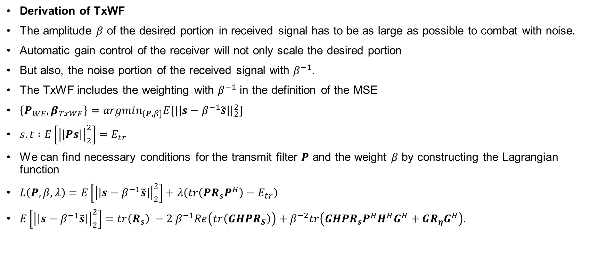
Transmit Wiener Filter (TxWF)
Derivation of TxWF
The amplitude $β$ of the desired portion in received signal has to be as large as possible to combat with noise.
Automatic gain control of the receiver will not only scale the desired portion
But also, the noise portion of the received signal with $β^{−1}$.
The TxWF includes the weighting with $β^{−1}$ in the definition of the MSE
$\left\{P_{WF},β_{TxWF}\right\}=argmin_{\left\{P,β\right\}}E[{|\left|s−β^{−1}\tilde{s}\right||}_{2}^{2}]$
$s.t :E\left[{\left|\left|Ps\right|\right|}_{2}^{2}\right]=E_{tr}$
We can find necessary conditions for the transmit filter $P$ and the weight $β$ by constructing the Lagrangian function
$L\left(P,β,λ\right)=E\left[{\left|\left|s−β^{−1}\tilde{s}\right|\right|}_{2}^{2}\right]+λ\left(tr\left(PR_{s}P^{H}\right)−E_{tr}\right)$
$E\left[{\left|\left|s−β^{−1}\tilde{s}\right|\right|}_{2}^{2}\right]=tr\left(R_{s}\right) −2 β^{−1}Re\left(tr\left(GHPR_{S}\right)\right)+β^{−2}tr\left(GHPR_{s}P^{H}H^{H}G^{H}+GR_{η}G^{H}\right).$

Slide 36
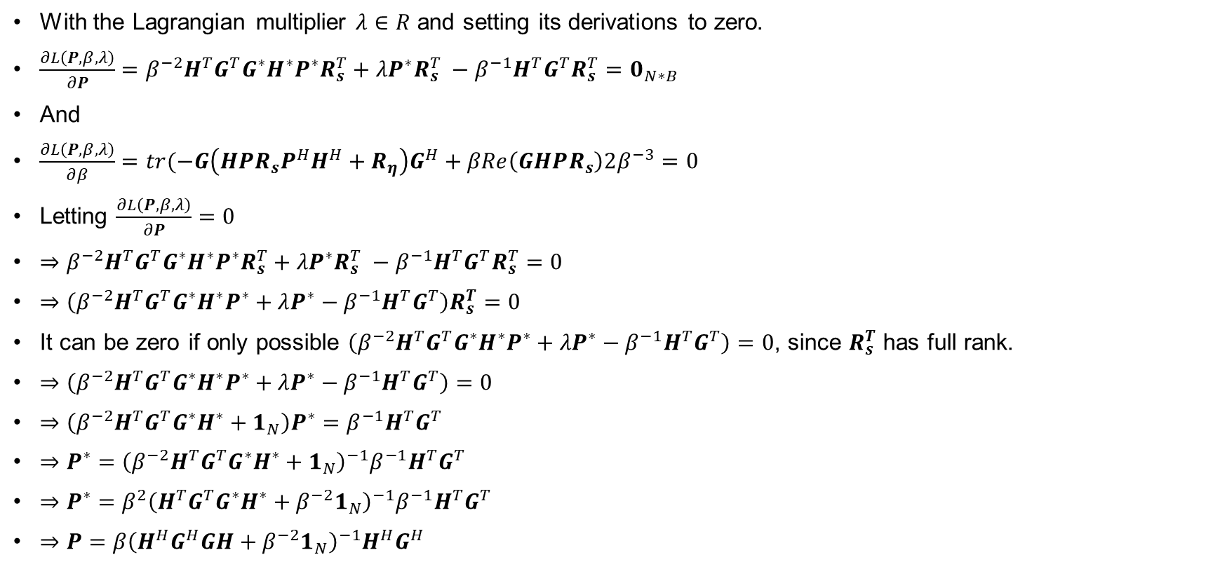
Transmit Wiener Filter (TxWF)
With the Lagrangian multiplier $λ∈R$ and setting its derivations to zero.
$\frac{∂L\left(P,β,λ\right)}{∂P}=β^{−2}H^{T}G^{T}G^{∗}H^{∗}P^{∗}R_{s}^{T}+λP^{∗}R_{s}^{T} −β^{−1}H^{T}G^{T}R_{s}^{T}=0_{N∗B}$
And
$\frac{∂L\left(P,β,λ\right)}{∂β}=tr(−G\left({HPR_{s}P}^{H}H^{H}+R_{η}\right)G^{H}+βRe\left(GHPR_{s}\right)2β^{−3}=0$
Letting $\frac{∂L\left(P,β,λ\right)}{∂P}=0$
$⇒β^{−2}H^{T}G^{T}G^{∗}H^{∗}P^{∗}R_{s}^{T}+λP^{∗}R_{s}^{T} −β^{−1}H^{T}G^{T}R_{s}^{T}=0$
$⇒\left(β^{−2}H^{T}G^{T}G^{∗}H^{∗}P^{∗}+λP^{∗}−β^{−1}H^{T}G^{T}\right)R_{s}^{T}=0$
It can be zero if only possible $\left(β^{−2}H^{T}G^{T}G^{∗}H^{∗}P^{∗}+λP^{∗}−β^{−1}H^{T}G^{T}\right)=0$, since $R_{s}^{T}$ has full rank.
$⇒\left(β^{−2}H^{T}G^{T}G^{∗}H^{∗}P^{∗}+λP^{∗}−β^{−1}H^{T}G^{T}\right)=0$
$⇒\left(β^{−2}H^{T}G^{T}G^{∗}H^{∗}+1_{N}\right)P^{∗}=β^{−1}H^{T}G^{T}$
$⇒P^{∗}={\left(β^{−2}H^{T}G^{T}G^{∗}H^{∗}+1_{N}\right)}^{−1}{β^{−1}H}^{T}G^{T}$
$⇒P^{∗}=β^{2}{\left(H^{T}G^{T}G^{∗}H^{∗}+β^{−2}1_{N}\right)}^{−1}β^{−1}H^{T}G^{T}$
$⇒P=β{\left(H^{H}G^{H}GH+β^{−2}1_{N}\right)}^{−1}H^{H}G^{H}$

Slide 37

Transmit Wiener Filter (TxWF)
The structure of the resulting transmit filter follows from
$P\left(λβ^{2}\right)=β\tilde{P}\left(λβ^{2}\right)$
With
$\tilde{P} \left(λβ^{2}\right)={\left(H^{H}G^{H}GH+λβ^{2}1_{N}\right)}^{−1}H^{H}G^{H}$
And
$β^{2}tr(\tilde{P}\left(λβ^{2}\right)R_{s}{\tilde{P}}^{H}\left(λβ^{2}\right)=E_{tr}$
$⇒$ $β= \sqrt{\frac{E_{tr}}{tr(\tilde{P}\left(λβ^{2}\right)R_{s}{\tilde{P}}^{H}\left(λβ^{2}\right)}}$

